Slide 1
Financial Options

Slide 2
Option Basics
Financial Option
  A contract that gives its owner the right (but not the obligation) to purchase or sell an asset at a fixed price as some future date
Call Option
  A financial option that gives its owner the right to buy an asset
Put Option
  A financial option that gives its owner the right to sell an asset
Option Writer
  The seller of an option contract

Slide 3
Understanding Option Contracts
Exercising an Option
  When a holder of an option enforces the agreement and buys or sells a share of stock at the agreed-
  upon price
Strike Price (Exercise Price)
  The price at which an option holder buys or sells a share of stock when the option is exercised
Expiration Date
  The last date on which an option holder has the right to exercise the option

Slide 4
Understanding Option Contracts
American Option
  Options that allow their holders to exercise the option on any date up to, and including, the expiration date
European Option
  Options that allow their holders to exercise the option only on the expiration date
    Note: The names American and European have nothing to do with the location where the options are traded.

Slide 5
Understanding Option Contracts
The option buyer (holder)
  Holds the right to exercise the option and has a long position in the contract
The option seller (writer)
  Sells (or writes) the option and has a short position in the contract
  Because the long side has the option to exercise, the short side has an obligation to fulfill the contract if it
  is exercised.

Slide 6
Interpreting Stock Option Quotations
Stock options are traded on organized exchanges.
By convention, all traded options expire on the Saturday following the third Friday of the month.
Open Interest
  The total number of contracts of a particular option that have been written

Slide 7
Interpreting Stock Option
Quotations
At-the-money
  Describes an option whose exercise price is equal to the current stock price
In-the-money
  Describes an option whose value if immediately exercised would be positive
    Deep in-the-money describes an option that is in-the-money and for which the strike price and stock price are far apart
Out-of-the-money
  Describes an option whose value if immediately exercised would be negative
    Deep out-of-the-money describes an option that is out-of-the-money and for which the strike price and stock price are far apart

Slide 8
Options on Other Financial Securities
Although the most commonly traded options are on stocks, options on other financial assets, like the S&P 100, the S&P 500, the Dow, and the NYSE index, are also traded.
Hedge
  To reduce risk by holding contracts or securities
  whose payoffs are negatively correlated with some risk exposure
Speculate
  When investors use contracts or securities to place a bet on the direction in which they believe the market is likely to move

Slide 9
Option Payoffs at Expiration
Long Position in an Option Contract
  The value of a call option at expiration is
    Where S is the stock price at expiration, K is the exercise price, C is the value of the call option, and max is the maximum of the two quantities in the parentheses

Slide 10
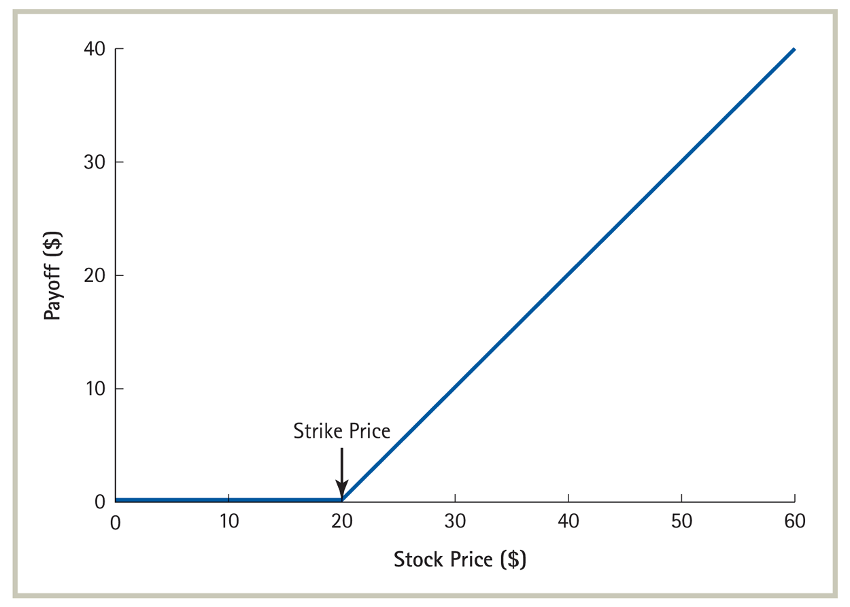
Payoff of a Call Option with a Strike Price of $20 at Expiration

Slide 11
Option Payoffs at Expiration
Long Position in an Option Contract
  The value of a put option at expiration is
    Where S is the stock price at expiration, K is the exercise price, P is the value of the put option, and max is the maximum of the two quantities in the parentheses

Slide 12
Short Position in an Option
An investor that sells an option has an obligation.
  This investor takes the opposite side of the contract to the investor who bought the option. Thus the seller’s cash flows are the negative of the buyer’s cash flows.

Slide 13
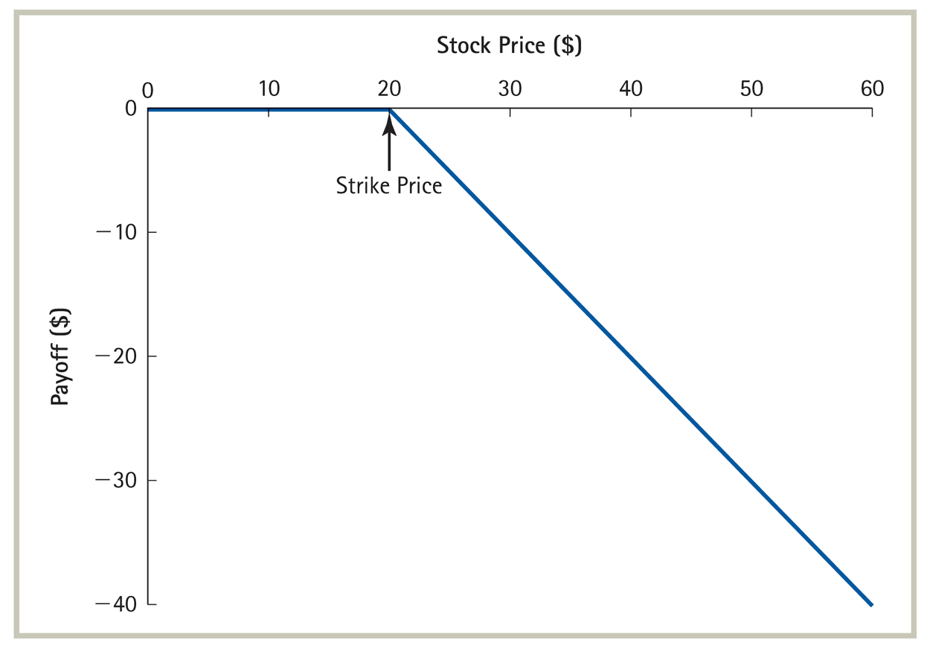
Short Position in a Call Option at Expiration

Slide 14
Combinations of Options
Straddle
  A portfolio that is long a call option and a put option on the same stock with the same exercise date and strike price
    This strategy may be used if investors expect the stock to be very volatile and move up or down a large amount, but do not necessarily have a view on which direction the stock will move.

Slide 15
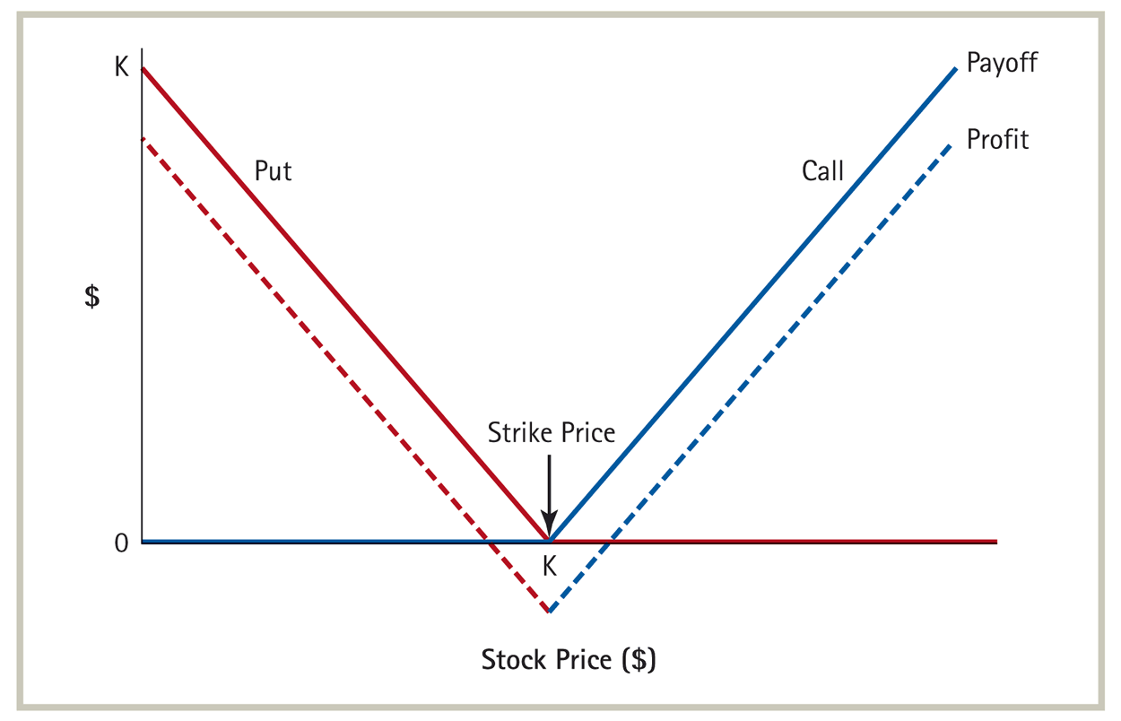
Payoff and Profit from a Straddle

Slide 16
Combinations of Options
Strangle
  A portfolio that is long a call option and a put option on the same stock with the same exercise date but the strike price on the call exceeds the strike price on the put

Slide 17
Combinations of Options
Butterfly Spread
  A portfolio that is long two call options with differing strike prices, and short two call options with a strike price equal to the average strike price of the first two calls
    While a straddle strategy makes money when the stock and strike prices are far apart, a butterfly spread makes money when the stock and strike prices are close.

Slide 18
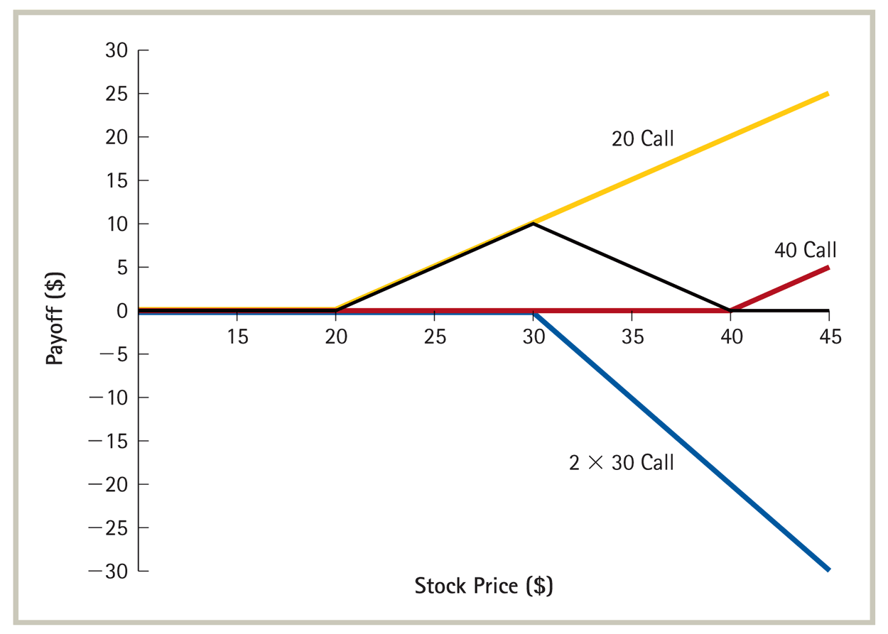
Butterfly Spread

Slide 19
Combinations of Options
Protective Put
  A long position in a put held on a stock you already own
Portfolio Insurance
  A protective put written on a portfolio rather than
  a single stock. When the put itself does not trade,
  it is synthetically created by constructing a replicating portfolio
  Portfolio insurance can also be achieved by purchasing a bond and a call option.

Slide 20
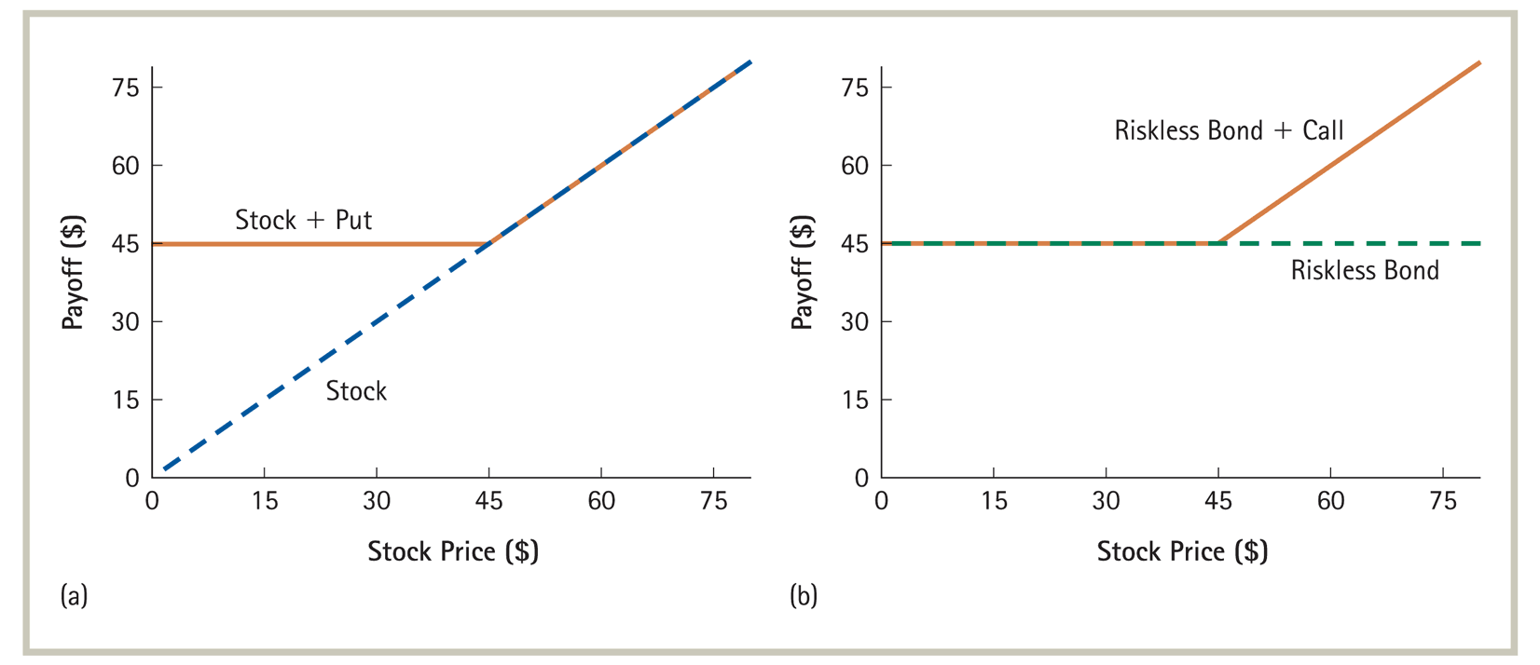
Portfolio Insurance

Slide 21
Put-Call Parity
Consider the two different ways to construct portfolio insurance discussed above.
  Purchase the stock and a put
  Purchase a bond and a call
Because both positions provide exactly the same payoff, the Law of One Price requires that they must have the same price.

Slide 22
Put-Call Parity
Therefore,
  Where K is the strike price of the option (the price
  you want to ensure that the stock will not drop below in the case of portfolio insurance), C is the call price, P is the put price, and S is the stock price

Slide 23
Put-Call Parity
Rearranging the terms gives an expression for the price of a European call option for a non-dividend-paying stock.
  This relationship between the value of the stock,
  the bond, and call and put options is known as
  put-call parity.

Slide 24
Example
Problem
  Assume:
    You want to buy a one-year call option and put option on Dell.
    The strike price for each is $25.
    The current price per share of Dell is $21.87.
    The risk-free rate is 5.5%.
    The price of each call is $2.85
  Using put-call parity, what should be the price of each put?

Slide 25
Example
Solution
  Put-Call Parity states:

Slide 26
Put-Call Parity
If the stock pays a dividend, put-call
parity becomes

Slide 27
Factors Affecting Option Prices
Strike Price and Stock Price
  The value of a call option increases (decreases) as
  the strike price decreases (increases), all other things held constant.
  The value of a put option increases (decreases) as
  the strike price increases (decreases), all other things held constant.

Slide 28
Factors Affecting Option Prices
Strike Price and Stock Price
  The value of a call option increases (decreases) as
  the stock price increases (decreases), all other things held constant.
  The value of a put option increases (decreases) as
  the stock price decreases (increases), all other things held constant.

Slide 29
Arbitrage Bounds on Option Prices
An American option cannot be worth less than its European counterpart.
A put option cannot be worth more than its
strike price.
A call option cannot be worth more than the
stock itself.

Slide 30
Arbitrage Bounds on Option Prices
Intrinsic Value
  The amount by which an option is in-the-money, or zero if the option is out-of-the-money
    An American option cannot be worth less than its
    intrinsic value
Time Value (sometimes called Option Value)
  The difference between an option’s price and its intrinsic value
    An American option cannot have a negative time value.

Slide 31
Option Prices and the Exercise Date
For American options, the longer the time to the exercise date, the more valuable the option
  An American option with a later exercise date cannot be worth less than an otherwise identical American option with an earlier exercise date.
    However, a European option with a later exercise date can be worth less than an otherwise identical European option with an earlier exercise date

Slide 32
Option Prices and Volatility
The value of an option generally increases with the volatility of the stock.

Slide 33
Exercising Options Early
Although an American option cannot be worth less than its European counterpart, they may have equal value.

Slide 34
Non-Dividend-Paying Stocks
For a non-dividend paying stock, Put-Call Parity can be written as
  Where dis(K) is the amount of the discount from face value of the zero-coupon bond K

Slide 35
Non-Dividend-Paying Stocks
Because dis(K) and P must be positive before the expiration date, a European call always has a positive time value.
  Since an American option is worth at least as much as a European option, it must also have a positive time value before expiration.
    Thus, the price of any call option on a non-dividend-paying stock always exceeds its intrinsic value prior to expiration.

Slide 36
Non-Dividend-Paying Stocks
This implies that it is never optimal to exercise a call option on a non-dividend paying stock early.
  You are always better off just selling the option.
  Because it is never optimal to exercise an American call on a non-dividend-paying stock early, an American call on a non-dividend paying stock has the same price as its European counterpart.

Slide 37
Non-Dividend-Paying Stocks
However, it may be optimal to exercise a put option on a non-dividend paying stock early.

Slide 38
Non-Dividend-Paying Stocks
When a put option is sufficiently deep in-the-money, dis(K) will be large relative to the value of the call, and the time value of a European put option will be negative. In that case, the European put will sell for less than its intrinsic value.
  However, its American counterpart cannot sell for less than its intrinsic value, which implies that an American put option can be worth more than an otherwise identical European option.

Slide 39
Options and Corporate Finance
Equity as a Call Option
  A share of stock can be thought of as a call option on the assets of the firm with a strike price equal to the value of debt outstanding.
    If the firm’s value does not exceed the value of debt outstanding at the end of the period, the firm must declare bankruptcy and the equity holders receive nothing.
    If the value exceeds the value of debt outstanding,
    the equity holders get whatever is left once the debt has been repaid.

Slide 40
Debt as an Option Portfolio
Debt holders can be viewed as owners of the firm having sold a call option with a strike price equal to the required debt payment.
  If the value of the firm exceeds the required debt payment, the call will be exercised; the debt holders will therefore receive the strike price and give up the firm.
  If the value of the firm does not exceed the required debt payment, the call will be worthless, the firm will declare bankruptcy, and the debt holders will be entitled to the firm’s assets.

Slide 41
Debt as an Option Portfolio
Debt can also be viewed as a portfolio of riskless debt and a short position in a put option on the firm’s assets with a strike price equal to the required debt payment.
  When the firm’s assets are worth less than the required debt payment, the owner of the put option will exercise the option and receive the difference between the required debt payment and the firm’s asset value. This leaves the debt holder with just the assets of the firm.
  If the firm’s value is greater than the required debt payment, the debt holder only receives the required debt payment.

Slide 42
Binomial Option Pricing Model
Can we find the correct price of a one year call on AIM Inc. stock?
AIM has a current stock price of $24 and in one year will the stock price will be either $14 or $38.
If we can find a portfolio of AIM stock and a risk free bond that mimics the payoff on the call we can price the call. (Assume r_{f} = 10%.)
That portfolio and the call must have the same price. Why?
We can price the portfolio since we know the current price of the stock and the bond.

Slide 43
Binomial Model
The payoff at expiration on the call option is $0 if the stock price goes down to $14 and is $13 if the stock price rises to $38.
  This is a change of $13 (13 – 0) from a “bad” to a “good” outcome.
For one share of stock, however, there is a change of $24 (38 – 24) across outcomes, making it difficult to replicate the option by holding a share of stock.
What if we buy 13/24^{ths} of a share of stock?
  The payoff on this position is $7.58 if the stock price goes down and $20.58 if it goes up (20.58 – 7.58 = 13).
  The position costs $13 since a share costs $24.
  The number 13/24 is called the “hedge ratio” or “delta” of this option.

Slide 44
Binomial Model
The value of our position now changes by $13 for an up versus a down move in stock price.
The only problem is that the payoff does not exactly match the call payoff.
This is easily corrected however if we could subtract $7.58 from each outcome on our position in the stock.
We can do that by borrowing so we have to repay exactly $7.58 at the expiration of the call.

Slide 45
Binomial Model
A portfolio that is long 13/24^{ths} of a share of stock and borrows $6.89 ($7.58/(1.1)) has a payoff of $0 ($7.58 - $7.58) if the stock price falls to $14 and a payoff of $13 ($20.58 - $7.58) if the stock price rises.
This perfectly mimics the payoffs to the call option.
The cost (price) of this portfolio must be exactly the same as the price of the call.
C = $13(13/24×$24) – $6.89($7.58/(1.1)) = $6.11

Slide 46
Binomial Model
This model, while very simple, captures the essence of most option pricing models.
The famous Black Scholes option pricing model follows from exactly this same logic, the main difference is that rather than a binomial model to capture stock prices we use a geometric Brownian motion (a continuous time stochastic process).
While there have been various extensions of the simple option pricing model, allowing random “jumps” in the stock price, stochastic volatility, etc., many of them still rely on the simple replicating portfolio argument presented in these notes.
Understanding options and the basics of option pricing can help in a variety of situations.

