Slide 1
Review: Pricing Policies and Levels
1
Dr. Yacheng Sun, UC Boulder
Notes:
1

Slide 2
Analytical Approaches to Profitability Analysis
2
Notes:
2

Slide 3
Incremental Percent Breakeven Sales Changes
3
Dr. Yacheng Sun, UC Boulder
3
Notes:
3

Slide 4
Price Sensitivity Drivers
4
Dr. Yacheng Sun, UC Boulder
Notes:
4

Slide 5
Risk Analytic Output from Profitability Analysis
5
Dr. Yacheng Sun, UC Boulder
Notes:
5

Slide 6
Lecture 8
Price Promotions
6
Dr. Yacheng Sun, UC Boulder
Notes:
Dr. Yacheng Sun UC Boulder
6

Slide 7
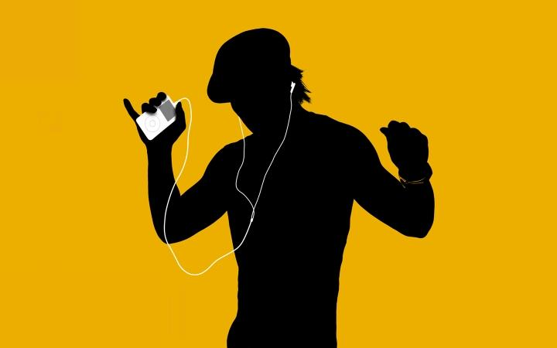
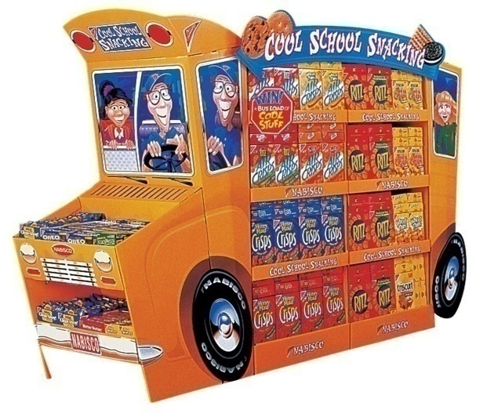
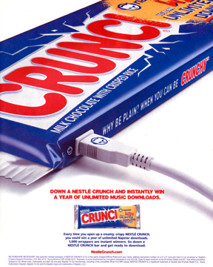
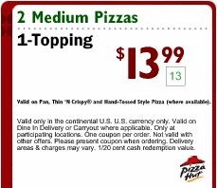
Various Sales Promotion Techniques
Advertisement
Point of purchase
Sweepstakes
7
Coupon and price promotion
Dr. Yacheng Sun, UC Boulder

Slide 8
Types of Sales Promotion
Product-Based
  Information and persuasion (Advertising)
  Generate Awareness (Free sampling)
  Reduce Risks (Special package)
  Place Promotions (End-of-Aisle displays)
Price-based
  Advertise low price
  Coupons: in-,on-pack, cross-ruff
8
Dr. Yacheng Sun, UC Boulder

Slide 9
Hierarchy of Communication Process
Awareness
Interest
Liking, Preference
Purchase, Action
9
Dr. Yacheng Sun, UC Boulder

Slide 10
Comparison: Advertising
The focus of advertising is to inform and impress consumers with the products/service
Inform consumers
  of product features and benefits
  Important for building primary demand
Persuasion
  Build brand preference or change buyer perceptions
  especially important for building demand in competitive markets.
Reminder advertising: maintain top-of-mind awareness
10
Dr. Yacheng Sun, UC Boulder
Notes:
10

Slide 11
Hierarchy of Communication Process
Awareness
Interest
Liking, Preference
Purchase, Action
11
Dr. Yacheng Sun, UC Boulder

Slide 12
Creative Strategy: Emotional vs. Rational Appeal
12
Dr. Yacheng Sun, UC Boulder
Emotional = appeal to psychological, social or symbolic needs. “Pull at the consumer’s heartstrings”
Rational = provide information about functional and utilitarian aspects of the products.
Shift towards emotional execution strategy in the later part of the product lifecycle
  Intense competition and proliferation of substitutable products (Michelin)
  Critical to increase “Product involvement”
  http://www.youtube.com/watch?v=sIkQRXkpwQI
  http://www.youtube.com/watch?v=HF_I68jCwHg
Notes:
12

Slide 13
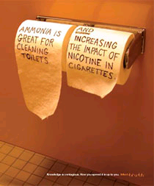
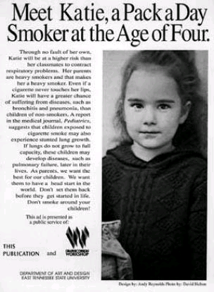
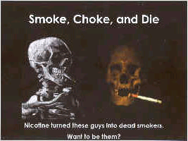
Taxonomy of Emotional Appeals
Fear appeal
can be an effective motivator but has the danger of alienating consumers
  Show the consumer how to avoid the problem.
  Provide concrete supporting information
13
Dr. Yacheng Sun, UC Boulder
Notes:
13

Slide 14
Taxonomy of Emotional Appeals
Humor
  “Memorability” device.
  Humor should not clutter the product benefits.
  Execution detail: Show consumer how to avoid the problem.
  Pre-test to check if consumer
    i) recalls product benefit
    ii) Attitude_product versus Attitude_ad = will the message be persuasive and will the product be taken seriously.
  http://www.youtube.com/watch?v=kVCGBohc20k&mode=related&search
Fantasy
  seen often in cosmetics advertising
  http://www.youtube.com/watch?v=r1g5qcKcVCM
14
Dr. Yacheng Sun, UC Boulder

Slide 15
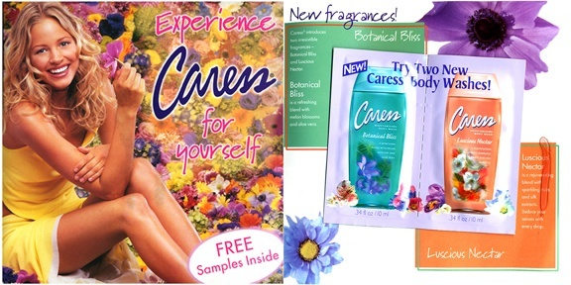
Other Forms of Product Promotion
  Free sample/sampling
    Good for products that are frequently purchased, high margin, benefit can be realized after one usage
      Soaps, cigar, software
    Advantages
      Induce trial quickly and broadly
      70% gain rate
15
Dr. Yacheng Sun, UC Boulder

Slide 16
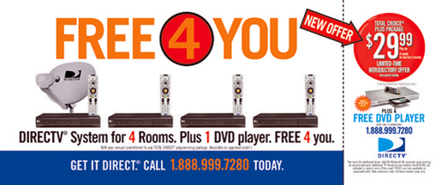
Other Forms of Product Promotion
  Special Package: price incentive to induce trial
    offer in a form that minimize initial outlay
    Criterion
      benefit the end user, not distributor's margin
      end user perceive price cut as a special offer
      to first time buyer, not repeat buyers
16
Dr. Yacheng Sun, UC Boulder

Slide 17
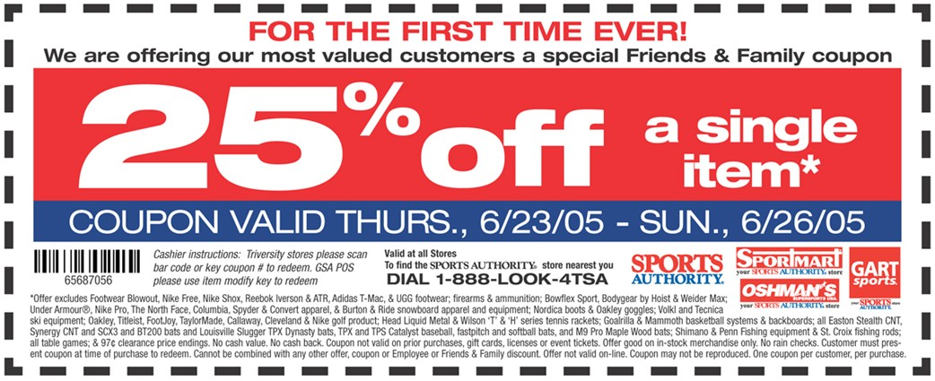
Forms of Price Promotion
Fact: about 25% of coupon redeemed do not have purchase
  Coupon
    Advantages
      Most popular
      Go to ultimate customer, maintain price image, can be directed to first time buyers
    Disadvantages
      Inconvenient, costly, retailer fraudulent
17
Dr. Yacheng Sun, UC Boulder

Slide 18
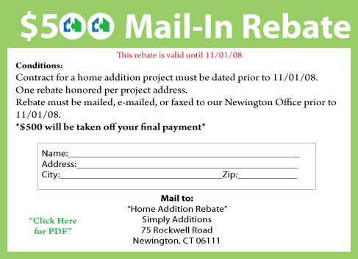
Forms of Price Promotion
  Rebate
    Advantages
      avoid coupon counterfeiting and fraudulent redemption by retailers
      limit the offer to one per family
      lower administration cost
      multiple products:
      help develop a list a deal prone consumers
      many consumers fail to redeem it
18
Dr. Yacheng Sun, UC Boulder

Slide 19
Forms of Price Promotion
  Reward program
  Refund
  Buy-now-pay-later
  Price matching
  Be creative!!!
19
Dr. Yacheng Sun, UC Boulder

Slide 20
A Few Facts about Promotions
* Price promotion effect is much stronger than price effect (silver-lining effect).
* Deals are more effective for new brands in inducing trials.
* Weaker brands feel higher pressure in price promotions.
20
Dr. Yacheng Sun, UC Boulder

Slide 21
A Few Facts about Promotions
* Marginal return of “Sales” sign is diminishing.
* Too-frequent price promotions train consumers to be price sensitive
* Too frequent sales can cast doubt on regular prices.
* Deals are not cures for generally “sick” products
21
21
Dr. Yacheng Sun, UC Boulder

Slide 22
Strategies of Timing Promotion
Fact # 1
Potential customers differ in their willingness-to-pay
Fact # 2
Such willingness-to-pay is usually correlated with their switching cost
A clear understanding of these two facts can help the company to maximize
The effectiveness of pricing by strategically timing promotion.
Dr. Yacheng Sun, UC Boulder

Slide 23
Timing of Price Promotion
Suppose that you are running a local mountain bike store and knows that you are looking at two types of customers.
  10% are casual shoppers, who are willing to pay $3,000 for the bike. Yet they are happy to pay a discount price.
  Casual shopper only shops on Saturday & Sunday.
  90% are deal seekers, who are only willing to pay $300 for the bike. Deal seekers check out the stores for prices 7 days a week.
  Your goal is to maximize the overall profit.
23
Dr. Yacheng Sun, UC Boulder

Slide 24
  How many price levels to use?
  What are the price levels?
  When do you want to do the sale?
  What will the total profit under the optimal pricing strategy?
24
Dr. Yacheng Sun, UC Boulder

Slide 25
When to Price Promote?
 | Mon | Tue | Wed | Thur | Fri | Sat | Sun
Sale?
Deal seekers
Casual shoppers
25
Dr. Yacheng Sun, UC Boulder

Slide 26
Suppose that you are running an online mountain bike store and knows that you are looking at two types of customers.
  10% are casual shoppers, who are willing to pay $3,000 for the bike. Yet they are happy to see a discount price.
  Casual shopper shop online with equal probability in either of the 7 days.
  90% are deal seekers, who are only willing to pay $300 for the bike. Deal seekers are online looking for deals 7 days a week.
  Your goal is to maximize the overall profit.
26
Dr. Yacheng Sun, UC Boulder

Slide 27
  How many price levels to use?
  What are the price levels?
  When do you want to do the sale?
  What will the total profit under the optimal pricing strategy?
27
Dr. Yacheng Sun, UC Boulder

Slide 28
When to Price Promote?
 | Mon | Tue | Wed | Thur | Fri | Sat | Sun
Sale?
Deal seekers
Casual shoppers
28
Dr. Yacheng Sun, UC Boulder

Slide 29
Next Lecture
Review – Exam 1
29
Dr. Yacheng Sun, UC Boulder
Notes:
29

