Slide 1
Lecture 6
Conjoint Analysis
1
Dr. Yacheng Sun, UC Boulder
Notes:
1

Slide 2
What is Conjoint Analysis?
Research technique developed in early 70s
Dictionary definition-- “Conjoint: Joined together, combined.”
Marketer’s catch-phrase-- “Features CONsidered JOINTly”
2
Dr. Yacheng Sun, UC Boulder

Slide 3
Demand Side of Equation
3
Dr. Yacheng Sun, UC Boulder
Typical market research role is to focus first on demand side of the equation
After figuring out what buyers want, next assess whether it can be built/provided in a cost- effective manner
Measures how buyers value components of a product/service bundle

Slide 4
Different Perspectives, Different Goals
Buyers want all of the most desirable features at lowest possible price
Sellers want to maximize profits by:
1) minimizing costs of providing features
2) providing products that offer greater overall value than the competition
4
Dr. Yacheng Sun, UC Boulder

Slide 5
A simple example
5
Dr. Yacheng Sun, UC Boulder
We want to market a new golf ball.
There are three important product features.
  Average Driving Distance
  Average Ball Life
  Price
Notes:
5

Slide 6
Example: Golf Ball
Average Driving Distance | Average Ball Life | Price
275 yards | 54 holes | $1.25
250 yards | 36 holes | $1.50
225 yards | 18 holes | $1.75
6
Dr. Yacheng Sun, UC Boulder
Notes:
6

Slide 7
7
Dr. Yacheng Sun, UC Boulder
Obviously, the “ideal” ball from consumers’ view is:
  Average Driving Distance: 275 yards
  Average Ball Life: 54 holes
  Price: $1.25
The “ideal” ball from manufacturers’ view is:
  Average Driving Distance: 225 yards
  Average Ball Life: 18 holes
  Price: $1.75
Lose money selling the first, but consumers won’t be happy with the second option.
Notes:
7

Slide 8
Breaking the Problem Down
If we learn how buyers value the components of a product, we are in a better position to design those that improve profitability
8
Dr. Yacheng Sun, UC Boulder

Slide 9
How to Learn What Customers Want?
Ask Direct Questions about preference:
  What brand do you prefer?
  What Interest Rate would you like?
  What Annual Fee would you like?
  What Credit Limit would you like?
Answers often trivial and unenlightening (e.g. respondents prefer low fees to high fees, higher credit limits to low credit limits)
9
Dr. Yacheng Sun, UC Boulder

Slide 10
How to Learn What Is Important?
Ask Direct Questions about importances
  How important is it that you get the <<brand, interest rate, annual fee, credit limit>> that you want?
10
Dr. Yacheng Sun, UC Boulder

Slide 11
Stated Importances
Importance Ratings often have low discrimination:
11
Dr. Yacheng Sun, UC Boulder

Slide 12
Stated Importances
Answers often have ______________, with most answers falling in “very important” categories
Answers sometimes useful for segmenting market, but still not as actionable as could be
12
Dr. Yacheng Sun, UC Boulder

Slide 13
Self-Explicated, Multi-Attribute Models
Self-explicated models use a combination of the “Which brands do you prefer?” and “How important is brand?” questions
  For each attribute (brand, price, performance, etc.) respondents rate or rank the levels within that attribute
  Respondents rate an overall importance for the attribute, when considering the various levels involved
Preference scores (utilities) can be developed by combining the preferences for levels with the importance of the attribute overall
13
Dr. Yacheng Sun, UC Boulder

Slide 14
Self-Explicated Models (continued)
Self-explicated models can be used to study many attributes and levels in a questionnaire
Some researchers refer to self-explicated models as “self-explicated conjoint,” but this is a ________ as no ________________ are involved
In certain cases, self-explicated models perform as well as conjoint analysis
Most researchers favor conjoint analysis or discrete choice modeling, when the project allows
14
Dr. Yacheng Sun, UC Boulder

Slide 15
Conjoint Analysis
15
Dr. Yacheng Sun, UC Boulder

Slide 16
How Does Conjoint Analysis Work?
Vary the product features (independent variables) to build many (usually 12 or more) product concepts
Ask respondents to rate/rank those product concepts (dependent variable)
Based on the respondents’ evaluations of the product concepts, figure out how much unique value (utility) each of the features added
(Regress dependent variable on independent variables; betas equal part worth utilities.)
16
Dr. Yacheng Sun, UC Boulder

Slide 17
What’s So Good about Conjoint?
More realistic questions:
Would you prefer . . .
210 Horsepower or 140 Horsepower
17 MPG 28 MPG
If choose left, you prefer Power. If choose right, you prefer Fuel Economy
Rather than ask directly whether you prefer Power over Fuel Economy, we present realistic tradeoff scenarios and infer preferences from your product choices
17
Dr. Yacheng Sun, UC Boulder

Slide 18
What’s So Good about Conjoint? (cont)
When respondents are forced to make difficult tradeoffs, we learn what they truly value
18
Dr. Yacheng Sun, UC Boulder
Dr. Yacheng Sun, UC Boulder

Slide 19
Conjoint Study Process
Stage 1 —Designing the conjoint study:
Step 1.1: Select attributes relevant to the product or service category,
Step 1.2: Select levels for each attribute, and
Step 1.3: Develop the product bundles to be evaluated.
Stage 2 —Obtaining data from a sample of respondents:
Step 2.1: Design a data-collection procedure, and
Step 2.2: Select a computation method for obtaining part-worth functions.
Stage 3 —Evaluating product design options:
Step 3.1: Segment customers based on their part-worth functions,
Step 3.2: Design market simulations, and
Step 3.3: Select choice rule.
19
ME Conjoint Analysis 2006 - 19
Notes:
19

Slide 20
State 1 – Design the Conjoint Study
20
Dr. Yacheng Sun, UC Boulder

Slide 21
Attributes assumed to be independent (Brand, Speed, Color, Price, etc.)
Each attribute has varying degrees, or “levels”
  Brand: Coke, Pepsi, Sprite
  Speed: 5 pages per minute, 10 pages per minute
  Color: Red, Blue, Green, Black
Each level is assumed to be ________________ of the others (a product has one and only one level of that attribute)
21
Dr. Yacheng Sun, UC Boulder

Slide 22
Rules for Formulating Attribute Levels
Levels are assumed to be mutually exclusive
Attribute: Add-on features
level 1: Sunroof
level 2: GPS System
level 3: Video Screen
  If define levels in this way, you cannot determine the value of providing two or three of these features at the same time
22
Dr. Yacheng Sun, UC Boulder

Slide 23
Rules for Formulating Attribute Levels
Levels should have ________________ meaning
“Very expensive” vs. “Costs $575”
“Weight: 5 to 7 kilos” vs. “Weight 6 kilos”
  One description leaves meaning up to individual interpretation, while the other does not
23
Dr. Yacheng Sun, UC Boulder

Slide 24
Rules for Formulating Attribute Levels
Don’t include too many levels for any one attribute
  The usual number is about 3 to 5 levels per attribute
  The temptation (for example) is to include many, many levels of price, so we can estimate people’s preferences for each
  But, you spread your precious observations across more parameters to be estimated, resulting in noisier (less precise) measurement of ALL price levels
  Also, needs to beware of “________________”
24
Dr. Yacheng Sun, UC Boulder

Slide 25
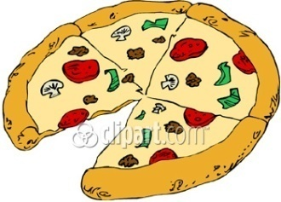
Designing a Frozen Pizza
Attributes
Type of crust (3 types)
Type of cheese (3 types)
Price (3 levels)
Topping (4 varieties)
Amount of cheese (2 levels)
Crust
Topping
Type of cheese
Pan
Thin
Thick
Pineapple
Veggie
Sausage
Pepperoni
Romano
Mixed cheese
Mozzeralla
Amount of cheese
Price
2 Oz.
6 Oz.
$9.99
$8.99
$7.99
Note: The example in the book also has a 4 oz option for amount of cheese.
A total of 216 (3x4x3x2x3) different pizzas can be developed from these options!
25
Dr. Yacheng Sun, UC Boulder
Notes:
25

Slide 26
State 2 – Obtain Data from A Sample of Respondents
26
Dr. Yacheng Sun, UC Boulder

Slide 27
27
Dr. Yacheng Sun, UC Boulder
Methods of Obtaining Data from respondents
  Pair-wise evaluation
  Rank-ordering product bundles
  Evaluating products on a rating scale
Notes:
27

Slide 28
Example: Design Frozen Pizza
28
Dr. Yacheng Sun, UC Boulder
Notes:
28

Slide 29
Preference Data for Frozen Pizzas
29
Dr. Yacheng Sun, UC Boulder
Notes:
29
Each level is assumed to be mutually exclusive of the others (a product has one and only one level of that attribute)

Slide 30
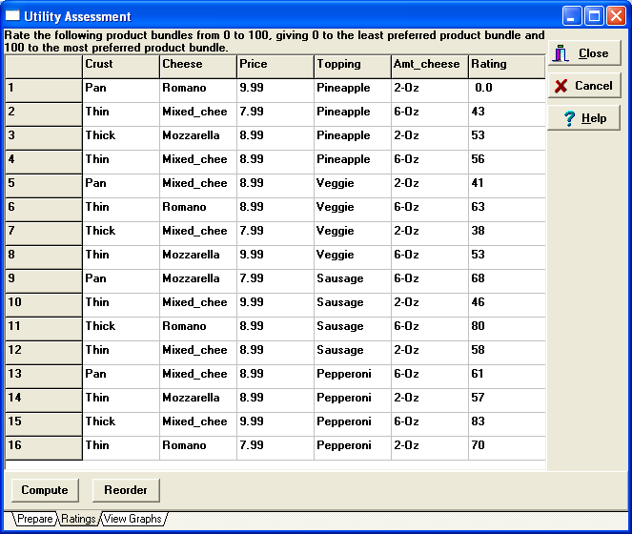
Designing a Frozen Pizza Example Ratings Data
30
Dr. Yacheng Sun, UC Boulder
Notes:
30

Slide 31
State 3 – Evaluate Product Design Options
31
Dr. Yacheng Sun, UC Boulder

Slide 32
Conjoint Utility Computations
k
m
j
U(P) = Σ Σ a_{ij}x_{ij}
j=1
i=1
P: A particular product/concept of interest
U(P): The utility associated with product P
a_{ij}: Utility associated with the jth level (j = 1, 2, 3...k_{j}) on the ith attribute
k_{j}: Number of levels of attribute i
m: Number of attributes
x_{ij}: 1 if the jth level of the ith attribute is present in product P, 0 otherwise
32
Dr. Yacheng Sun, UC Boulder
Notes:
32

Slide 33
Utility Computation (Designing a Frozen Pizza)
Customer’s Utility
Cust 1 Cust 2 Cust 3
Base* 0 45 30
Thin crust 10 -5 0
Thick crust 15 10 0
Veggie 10 0 50
Sausage 25 5 0
Pepperoni 30 20 0
Mixed Cheese 3 -10 0
Mozzarella 10 10 -5
6 oz 10 15 -20
$ 8.99 20 -10 10
$ 7.99 35 -5 20
33
Dr. Yacheng Sun, UC Boulder
Notes:
33

Slide 34
Market Share and Revenue Share Forecasts
Define the competitive set – this is the set of products from which customers in the target segment make their choices. Some of them may be existing products and, others concepts being evaluated. We denote this set of products as P₁, P₂,...P_{N}.
Select Choice rule
  Maximum utility rule
  Share of preference rule
  Logit choice rule
34
Dr. Yacheng Sun, UC Boulder
Notes:
34

Slide 35
Maximum Utility Rule (Example)
Under this choice rule, each customer selects the product that offers him/her the highest utility among the competing alternatives. Market share for product P_{i} is then given by:
K is the number of consumers who participated in the study.
35
Dr. Yacheng Sun, UC Boulder
Notes:
35

Slide 36
Other Choice Rules
Share of utility rule: Under this choice rule, the consumer selects each product with a probability that is proportional to ________________ compared to ____________________ derived from all the products in the choice set.
Logit choice rule: This is similar to the share of utility rule, except that it gives larger weights to more preferred alternatives and smaller weights to less preferred alternatives.
36
Dr. Yacheng Sun, UC Boulder
Notes:
36

Slide 37
Market Share Computation
(Designing a Frozen Pizza)
Consider a market with three customers and three products:
37
Dr. Yacheng Sun, UC Boulder
Notes:
37

Slide 38
Market Share Computation
(Designing a Frozen Pizza)
Utility (Value) of each product for each customer.
Maximum Utility Rule: If we assume customers will only buy the product with the highest utility, the market share for Meat Lover’s treat is 2/3 and for Veggie Delite is 1/3.
Share of preference rule: If we assume that each customer will buy each product in proportion to its utility relative to the other products, then market shares for the three products are: Aloha Special (27.2%), Meat Lover’s Treat (27.9%) and Veggie Delite (44.9%).
38
Dr. Yacheng Sun, UC Boulder
Notes:
38

Slide 39
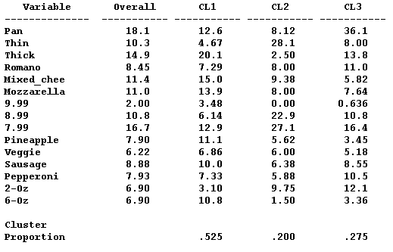
Identifying Segments Based on
Conjoint Part Worths
39
Dr. Yacheng Sun, UC Boulder
Notes:
39

Slide 40
Product Design for Specific Segments
Design optimal product by segment
  Segment 1 (Value segment – 52% of the market): A thick-crust pizza with 6 Oz mixed cheese and pineapple (or sausage) topping priced at $7.99. This will get about 32% share and revenue index of around 100 (the same as the base product).
  Segment 3 (Premium segment -- 27.5% of the market): A pan pizza with 2 Oz of Romano cheese and pepperoni or sausage topping priced at $9.99. This will get 31% share of this segment and have revenue index of about 100.
40
Dr. Yacheng Sun, UC Boulder
Notes:
40

Slide 41
Next class: Price Levels and Policies
Dr. Yacheng Sun, UC Boulder
Notes:
41

