Slide 1
Talking about BASE in Your Job Search
Leeds Professionalism Summit
Laura Kornish
Spring 2024
Notes:
https://docs.google.com/presentation/d/1wXEfl7FynZ1fa8zQWpfvIrF-s4-10QTqG-BYtM_87Ng/edit?usp=sharing

Slide 2
Me
I am Laura Kornish, a marketing professor at Leeds. I am the associate dean of the Leeds undergraduate programs.
I taught BASE in Spring 2020 and 2021.
kornish@colorado.edu
You
Please introduce yourself to someone you don’t already know.
And then I will ask a few of you to do introductions.

Slide 3
What is BASE?
BASE is a course designed to accelerate your development as professionals.

Slide 4
What is BASE? BCOR Applied Semester Experience
BASE is a core capstone where you integrate and apply what you learned in the core courses—the knowledge, hard skills, and soft skills.
EARLY STAGE
GROWTH STAGE
ESTABLISHED
SIMULATION
Leeds faculty developed the projects with Colorado-based showcase companies.

Slide 5
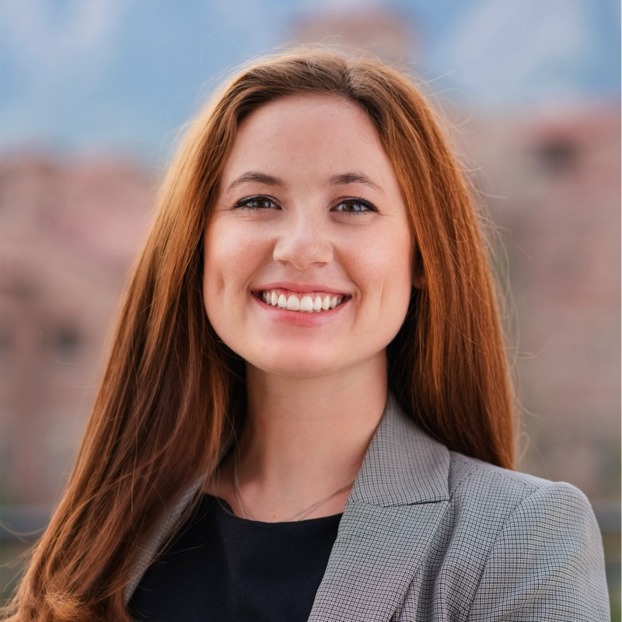
From Lindsey Hoffman, Leeds alum from December 2021
https://www.linkedin.com/in/lindseyjhoffman/
I didn't truly grasp the significance of BASE until beginning my professional career.
Throughout the course, I strengthened my ability to communicate effectively with leaders, collaborate with team members to leverage each other’s strengths, develop strategic problem-solving approaches, and consistently streamline communication.
These skills have proven as the foundation of my career success.

Slide 6
BASE in the job search
In networking, resume crafting, cover letter writing, and interviewing, BASE will give you specific and concrete examples to talk about.
BASE is unique to Leeds. There are no other integrated “lower division” capstones in business education.

Slide 7
BASE Projects are Classic Business Problems
New product category
Packaging recommendation
Selecting channels
Stretching your cash
Identifying new locations
Yes or no on a new venture (NDLS store)
New menu item
What that means for you: there is something from BASE that is relevant to any professional opportunity.

Slide 8
BASE Skills are Transferable and Universal
From a Data Analyst Internship at Epsilon:
Strong analytic thought process and ability to interpret findings.
Excellent communication skills, both verbal and written.
Detail-oriented able to multi-task, take initiative and prioritize in a fast-paced environment.
Able to work in a collaborative team and build effective relationships.
Notes:
https://www.linkedin.com/jobs/view/3825805802

Slide 9
BASE Skills are Transferable and Universal
From a Credit Analyst Business Banking-Healthcare position at US Bank:
Prior to…the final credit decision, the Credit Analyst conducts a complete credit analysis including gathering, analyzing, and interpreting all types of credit information on existing and prospective customers.
Notes:
https://www.linkedin.com/jobs/view/3798931697

Slide 10
BASE on your resume
Different ways to list it on your resume, under relevant courses:
BASE (Sophomore Integrated Capstone)
BASE (Business core Applied Semester Experience)
Sophomore Business Projects Course
Business Core Capstone
Be prepared to answer questions about anything on your resume!

Slide 11
BASE on your resume: Justin’s 1
Relevant projects:
Recommended [….] as a new product category for Justin’s, a consumer goods company best known for nut butter squeeze packs. Backed recommendation with financial, brand, competitive, and operational reasoning.

Slide 12
BASE on your resume: Justin’s 2
Relevant projects:
Recommended new packaging design for Justin’s, a consumer goods company best known for nut butter squeeze packs.

Slide 13
BASE on your resume: Spark 1
Relevant projects:
Recommended channels of distribution for Spark Mindset, a cybersecurity education company targeting underrepresented populations.

Slide 14
BASE on your resume: Spark 2
Relevant projects:
Built a Statement of Cash Flows (SCF) for Spark Mindset, a cybersecurity education company targeting underrepresented populations. Used the SCF to recommend operational changes to extend existing cash reserves.

Slide 15
BASE in an interview
BASE gives you experiences that you can share in interviews related to teamwork, challenges, skills, and more.

Slide 16
Interview questions: teamwork
Tell me about a time you worked in a team.
What role do you tend to play on a team?
In your opinion, what is a crucial element for successful teamwork?
Try to generate specific and concrete examples from BASE.

Slide 17
Interview questions: challenges
What is your biggest weakness?
Tell me about a time you failed.
How do you handle stress or pressure?
Give an example of how you have handled a delicate situation.
Talk me through a bad professional relationship you've had. Why didn't it work?
Try to generate specific and concrete examples from BASE.

Slide 18
Interview questions: skills and accomplishments
Tell me about a time you used data to make a recommendation.
What is your biggest strength?
Explain something you know well.
What single project or task would you consider your most significant career accomplishment to date? Walk me through the plan, how you managed it, how you measured success, and what the biggest mistakes you made were.
Try to generate specific and concrete examples from BASE.

Slide 19
What is BASE? BCOR Applied Semester Experience
BASE is a signature part of the Leeds curriculum.
EARLY STAGE
GROWTH STAGE
ESTABLISHED
SIMULATION
Employers will appreciate it in the hiring process and on the job.

