Slide 1
Case Study: Ideko
Valuing an Acquisition

Slide 2
Valuation Using Comparables
Consider Ideko Corporation, a privately held firm. The owner has decided to sell the business.
Your job, as a partner in KKP Investments, is to evaluate purchasing the company, implementing operational and financial improvements, and selling the business at the end of five years.

Slide 3
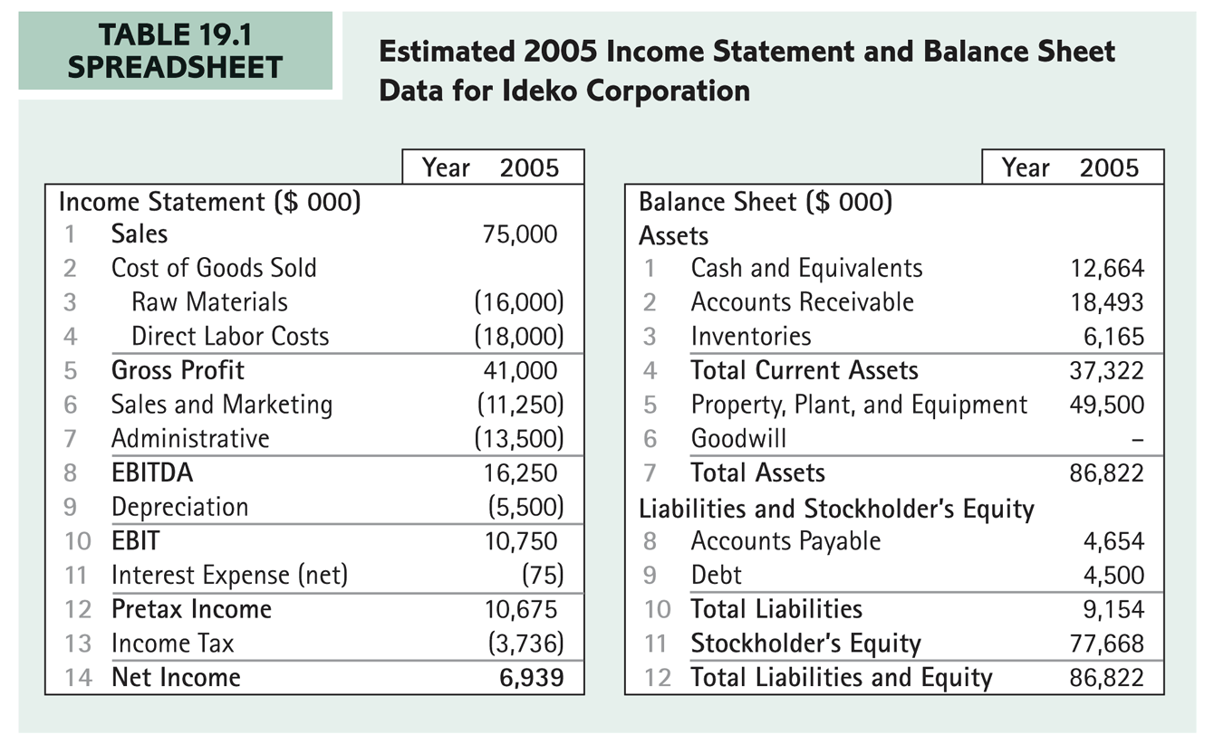
Financial Statements

Slide 4
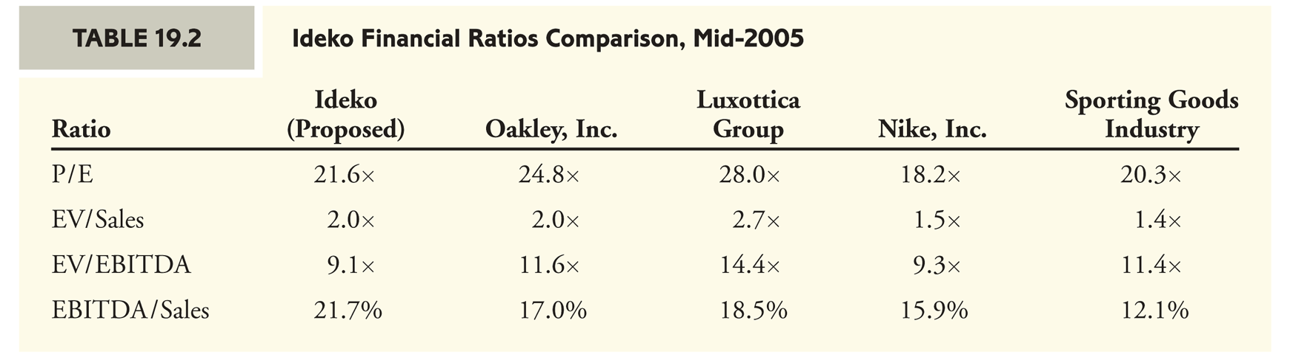
Common Financial Ratios

Slide 5
Valuation Using Comparables
A price of $150 million for Ideko’s equity has
been suggested.
  The data in the previous slide provides some reassurance that this acquisition price is reasonable as the ratios are about the level of or better than the industry averages.
  However, to assess whether this investment is attractive, the operational aspects of the firm and the ultimate cash flows the deal is expected to generate need to be analyzed.

Slide 6
The Business Plan
Operational Improvements
  By cutting administrative costs immediately and redirecting resources to new product development, sales, and marketing, you believe Ideko can increase its market share from 10% to 15% over the next five years.
  The increased sales demand can be met in the short run using the existing production lines. Once the growth in volume exceeds 50%, however, Ideko will need to undertake a major expansion to increase its manufacturing capacity. Furthermore:
    Ideko’s average selling price is forecast to increase 2% each year.
    Raw materials prices are forecast to increase at a 1% rate.
    Labor costs are forecast to increase at a 4% rate.

Slide 7
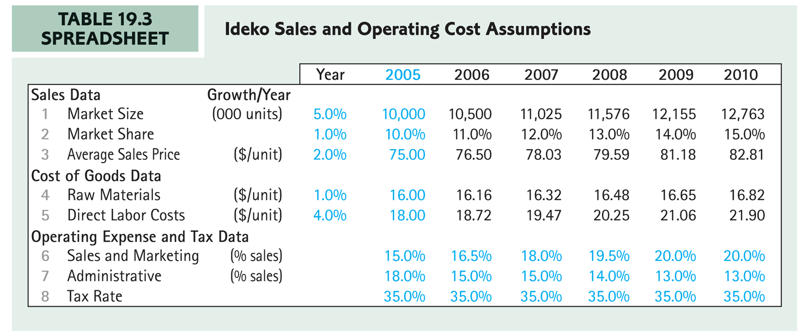
Sales and Cost Assumptions

Slide 8
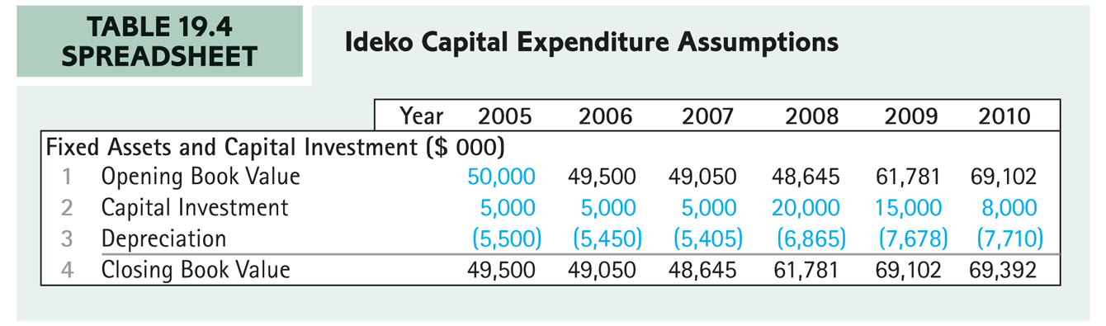
Capital Expenditures: A Needed Expansion
In 2008, a major expansion will be necessary, leading to a large increase in capital expenditures in 2008 and 2009.
Appropriate tax depreciation is also shown.

Slide 9
Working Capital Management
Ideko’s Accounts Receivable Days is:
  While the industry average is 60 days
  You believe that Ideko can tighten its credit policy to achieve the industry average without sacrificing sales.

Slide 10
Working Capital Management
Ideko’s inventory figure on its balance sheet includes $2 million of raw materials. Given raw material expenditures of $16 million for the year, Ideko currently holds 45.6 days worth of raw material inventory.
  (2 ∕ 16) × 365 = 45.6
You believe that, with tighter controls of the production process, 30 days worth of inventory will be adequate.

Slide 11
Capital Structure Changes: Levering Up
You believe Ideko is significantly underleveraged so you plan to increase the firm’s debt. The debt will have an interest rate of 6.8% and Ideko will only pay interest during the next five years.
The firm will also seek additional debt financing in 2008 and 2009 associated with the expansion.

Slide 12
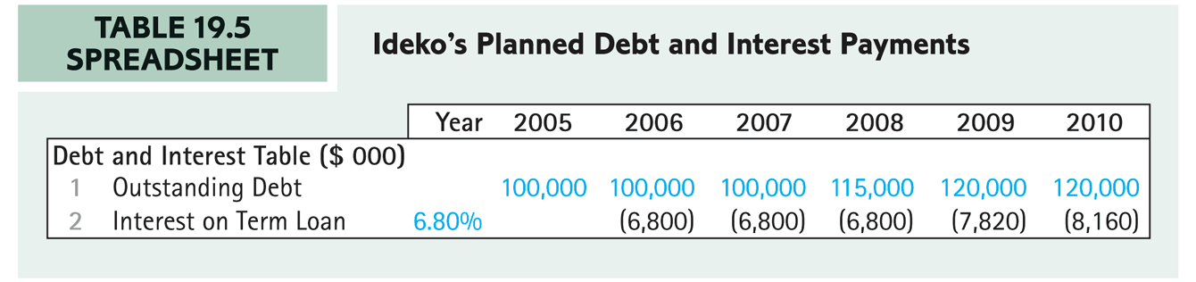
Capital Structure Changes: Levering Up
The forecasted interest expense each year is computed as:
Therefore:

Slide 13
Capital Structure Changes: Levering Up
In addition to the $150 million purchase price for
Ideko’s equity, $4.5 million will be used to repay
Ideko’s existing debt.
  With $5 million in transaction fees, the acquisition will require $159.5 million in total funds.
  KKP’s sources of funds include the new loan of $100 million
  as well as Ideko’s own excess cash ($6.5 million, which KKP will have access to). Thus KKP’s required equity contribution to the transaction is $53 million.

Slide 14
Building the Financial Model
Forecasting Earnings
  To build the pro forma income statement, begin with Ideko’s sales. Each year, sales can be calculated as:
  The raw materials cost (similarly for direct labor cost) can be calculated from sales as:

Slide 15
Building the Financial Model
Forecasting Earnings
  Sales and marketing and administrative costs can be computed directly as a percentage of sales.
  The corporate income tax is computed as:

Slide 16
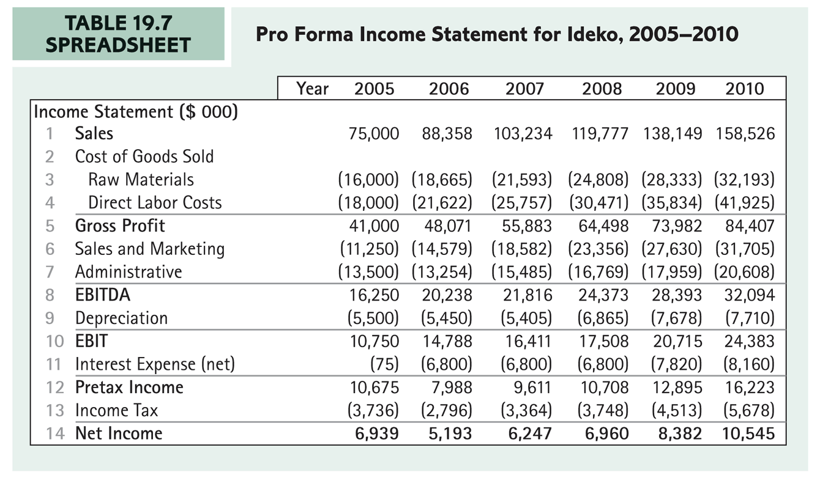
Pro Forma Income Statement

Slide 17
Working Capital Requirements
The working capital forecast should include the plans to tighten Ideko’s credit policy, speed up customer payments, and reduce Ideko’s inventory of raw materials.
  Accounts Receivable in 2006 is calculated as:

Slide 18
Working Capital Requirements
In order to capture the improvements in inventory management you want to reflect the change from 45.6 days of expenditures on raw materials in raw materials inventory to 30 days.
  Raw Materials Inventory in 2006 is calculated as:

Slide 19
Working Capital Requirements
The minimum cash balance is the minimum level of cash needed to keep the business running.
  Firms typically earn little or no interest on these balances. As a consequence, the opportunity cost of holding cash is accounted for by including the minimal cash balance as part of the firm’s working capital.
  Assume this is held at the current 30 days sales.

Slide 20
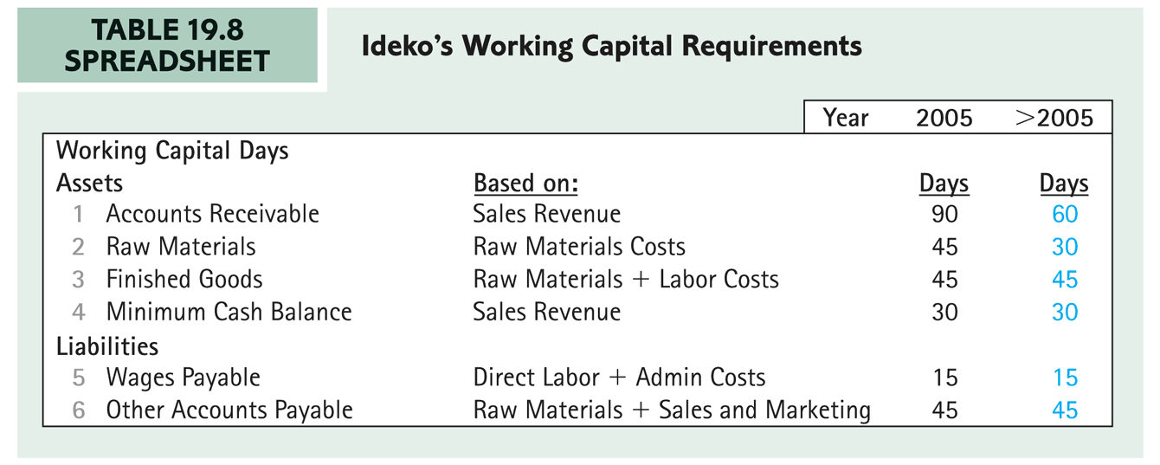
Working Capital Assumptions

Slide 21
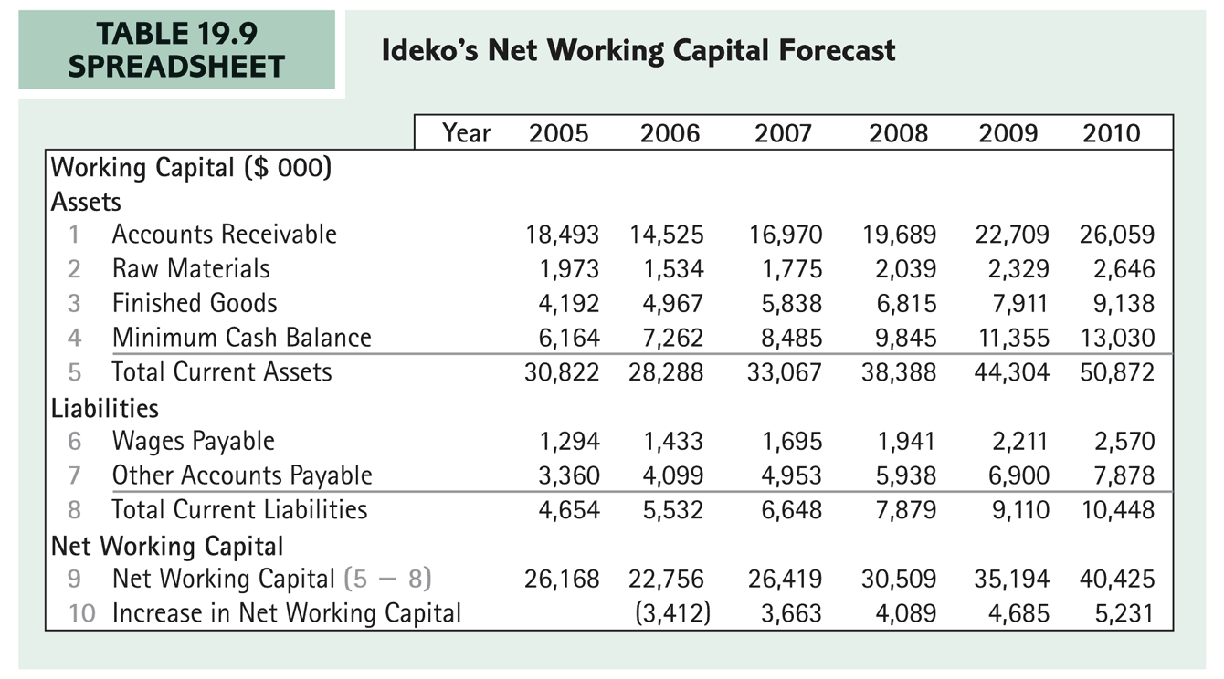
Working Capital Forecast

Slide 22
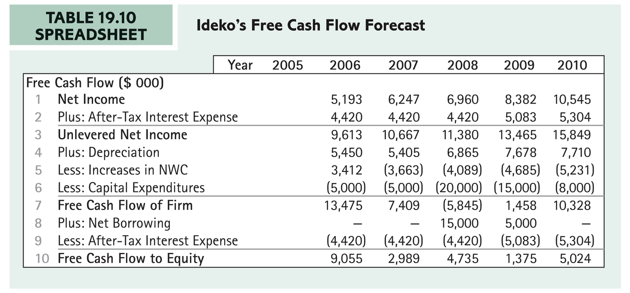
Free Cash Flow Forecast

Slide 23
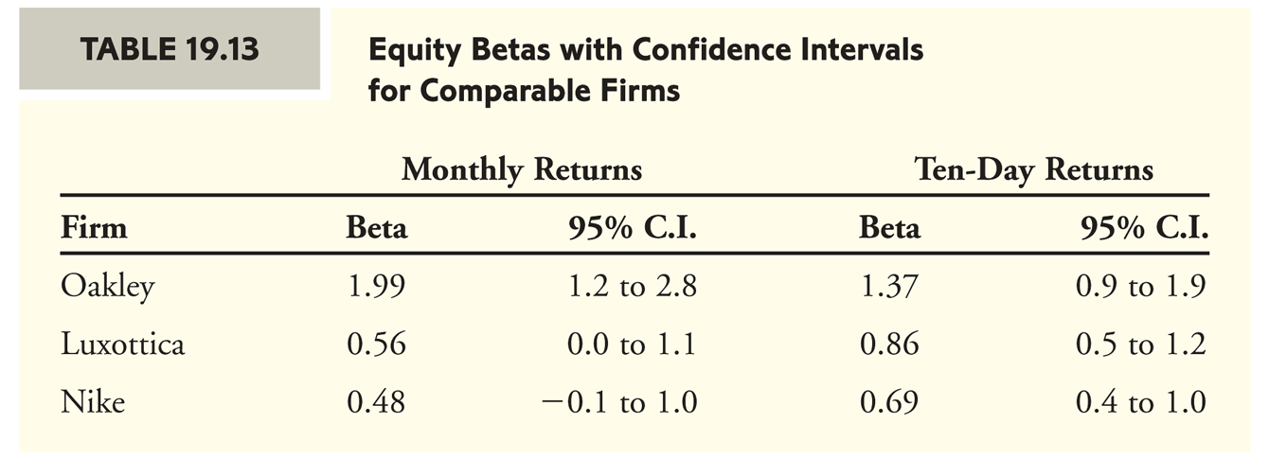
Beta Estimates For Comparable Firms

Slide 24
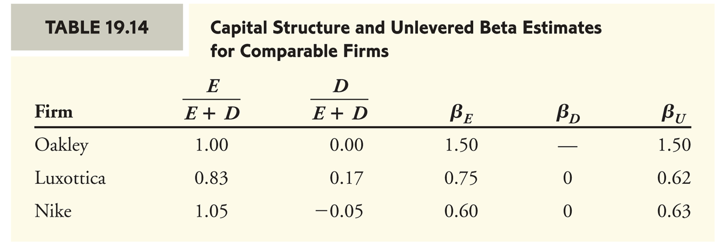
Unlevered Betas

Slide 25
Ideko’s Unlevered Cost of Capital
The data from the comparable firms provides guidance for estimating Ideko’s unlevered cost of capital.
  Ideko’s products are not as high end as Oakley’s eyewear, so Ideko’s sales are unlikely to vary as much with the business cycle as Oakley’s sales do.
  Ideko does not have a prescription eyewear division, as
  Luxottica does.
  Ideko’s products are fashion items rather than exercise items.

Slide 26
Ideko’s Unlevered Cost of Capital
Given the above analysis, Ideko’s cost of capital is likely to be closer to Oakley’s than to Nike’s or Luxottica’s. You decide to use 1.20 as your preliminary estimate for Ideko’s unlevered beta.
  Your estimate of Ideko’s unlevered cost of capital is:

Slide 27
Valuing the Investment
The Multiples Approach to Continuation Value
  Practitioners generally estimate a firm’s continuation value (also called the terminal value) at the end of the forecast horizon using a valuation multiple, with the EBITDA multiple being the multiple most often used in practice.

Slide 28
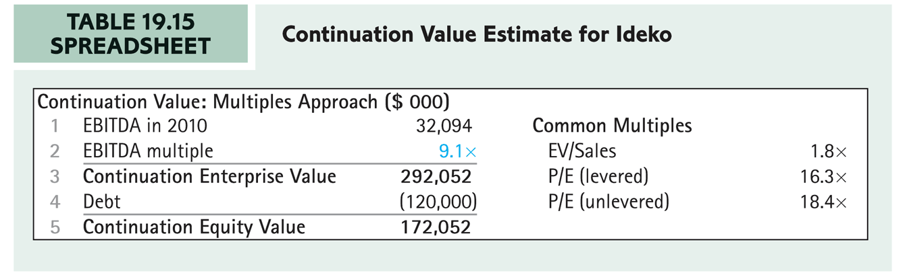
Continuation Multiples
  One difficulty with relying on comparables when forecasting a continuation value is that future multiples of the firm are being compared with current multiples of its competitors.

Slide 29
The Discounted Cash Flow Approach to Continuation Value
The enterprise value in year T, using the WACC valuation method, is calculated as:
Free cash flow in year T + 1 is computed as:

Slide 30
The Discounted Cash Flow Approach to Continuation Value
If firm’s sales are expected to grow at a nominal rate g and the firm’s operating expenses remain a fixed percentage of sales, then its unlevered net income will also grow at rate g.
  Similarly, the firm’s receivables, payables, and other elements of net working capital will grow at rate g.

Slide 31
The Discounted Cash Flow Approach to Continuation Value
If capital expenditures are defined as (so net fixed assets also grow at a rate g):
Then free cash flows at time t+1, given g, can be
estimated as:

Slide 32
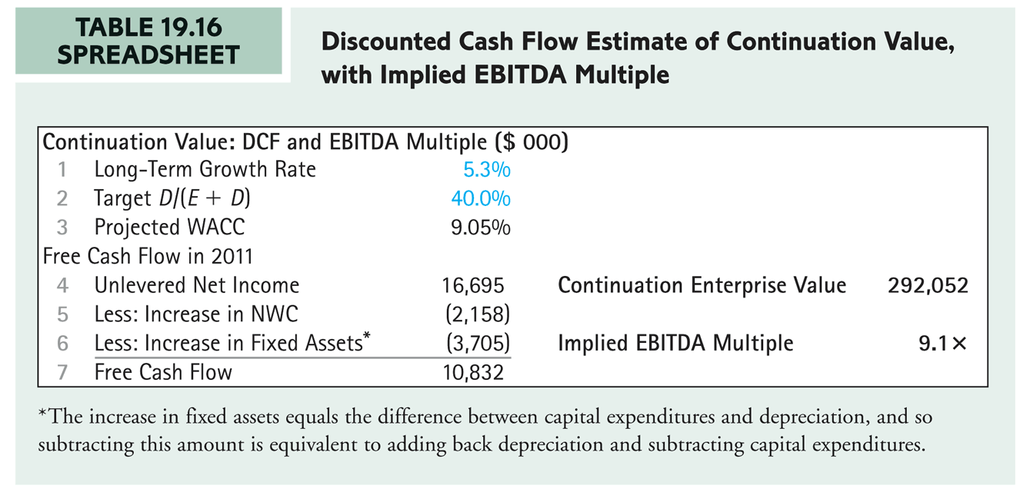
Continuation Value

Slide 33
The Discounted Cash Flow Approach to Continuation Value
The projected EBITDA multiple of 9.1 can be justified according to the discounted cash flow method with a nominal long-term growth rate of about 5.3%.
  Given an inflation rate of 2%, this nominal rate represents a real growth rate of about 3.3%.
    If this implied growth rate is much higher than the expectations of long-run growth for the industry as a whole, you should be very skeptical of the estimate being used.

Slide 34
APV Valuation of Ideko Equity
The estimate of Ideko’s continuation value can be combined with the forecasts for free cash flow through 2010 to estimate Ideko’s value today. The first step is to compute Ideko’s unlevered value.
Next, the present value of the interest tax shields needs to be computed.

Slide 35
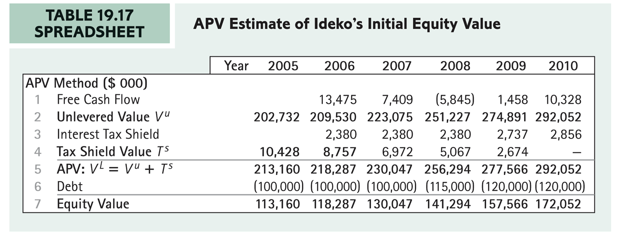
APV Estimate of Value
  Given that KKP’s initial cost to acquire Ideko’s equity is $53 million, the deal looks attractive with an NPV $60 million. $113 million − $53 million = $60 million

