Slide 1
Capital Structure

Slide 2
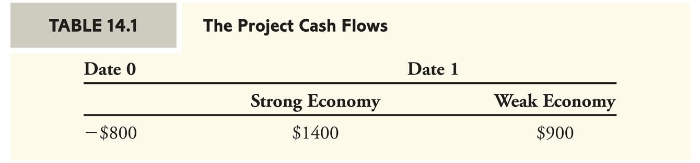
Financing a Firm with Equity
You are considering an investment opportunity.
  For an initial investment of $800 this year, the project will generate cash flows of either $1400 or $900 next year, depending on whether the economy is strong or weak, respectively. Both scenarios are equally likely.

Slide 3
Financing a Firm with Equity
The project cash flows depend on the overall economy and thus contain market risk. Therefore, you demand a 10% risk premium over the current risk-free interest rate of 5% to invest in assets with the same systematic risk level as this project.
The cost of capital for this project is 15%. The expected cash flow in one year is:
  ½($1400) + ½($900) = $1150.
The NPV of the project is therefore:

Slide 4
Financing a Firm with Equity
If you finance this project using only equity, how much would investors be willing to pay for the equity of the project?
    You can raise $1000 by selling all of the equity in the firm, after paying the investment cost of $800, you can keep the remaining $200, the NPV of the project NPV, as a profit.

Slide 5
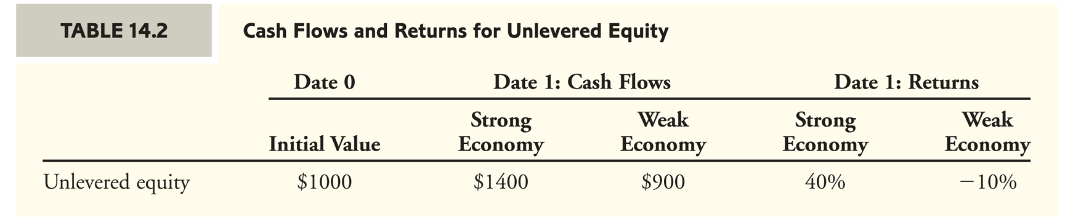
Financing a Firm with Equity
Unlevered Equity
  Equity in a firm that uses no debt financing.
Because there is no debt, the cash flows of the unlevered equity are equal to the cash flows of the project.
  Think about the balance sheet.

Slide 6
Financing a Firm with Equity
Shareholder’s returns are either 40% or –10%.
  The expected return on the unlevered equity is:
  ½ (40%) + ½(–10%) = 15%.
  Because the cost of capital of the project is 15%, shareholders are earning an appropriate expected return given the risk they are taking. In other words, the equity is fairly priced.

Slide 7
Financing a Firm with Debt and Equity
Levered Equity
  Equity in a firm that also has debt outstanding
Suppose instead that you decide to borrow $500 initially, in addition to selling equity.
  Because the project’s cash flow will always be enough to repay the debt, the debt is risk free and you can borrow at the risk-free interest rate of 5%. You will owe the debt holders:
  $500 × 1.05 = $525 in one year.

Slide 8
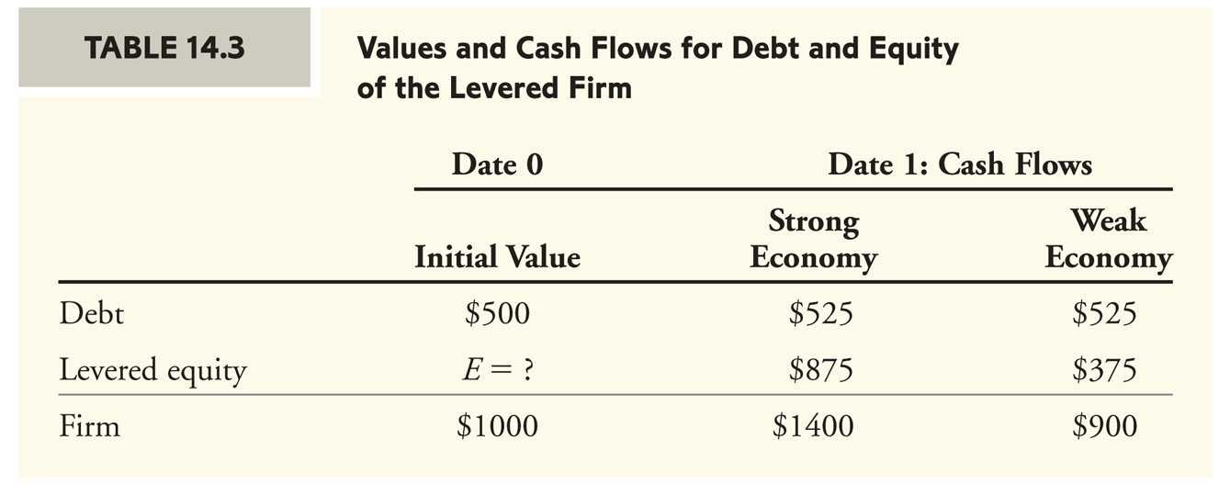
Financing a Firm with Debt and Equity
Given the firm’s $525 debt obligation, your shareholders will receive only $875 ($1400 – $525 = $875) in a strong economy and $375 ($900 – $525 = $375) in a weak economy.
  Will investors still pay $1,000 for the equity? Then what?

Slide 9
Financing a Firm with Debt and Equity
What price E should the levered equity sell for?
Which is the best capital structure choice for the entrepreneur? No debt or $500 in debt?
Modigliani and Miller argued that with perfect capital markets, the total value of a firm should not depend on its capital structure.
  They reasoned that the firm’s total cash flows still equal the cash flows of the project, and therefore must have the same total present value. In other words, firm value has not changed.

Slide 10
Financing a Firm with Debt and Equity
Because the cash flows of the debt and equity sum to the cash flows of the project, by the Law of One Price the combined values of debt and equity must be $1000.
  Therefore, if the current value of the debt is $500, the value of the levered equity must be $500.
  E = F – D = $1000 – $500 = $500.
    Again, think about the (market value) balance sheet.

Slide 11
Financing a Firm with Debt and Equity
Because the cash flows of levered equity are smaller than those of unlevered equity, levered equity will sell for a lower price ($500 versus $1000).
  However, you are not worse off. You will still raise a total of $1000 by issuing both debt and levered equity. Consequently, you would be indifferent between these two choices for the firm’s capital structure.

Slide 12
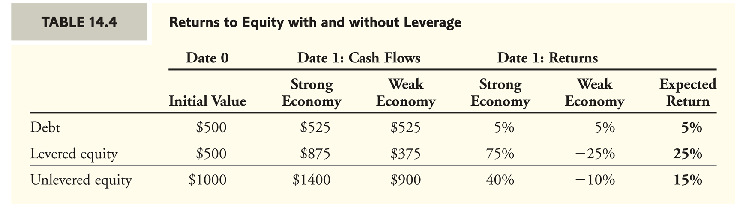
The Effect of Leverage on Risk and Return
Leverage increases the risk of the equity of a firm.
  Therefore, it is inappropriate to discount the cash flows of levered equity at the same discount rate of 15% used for unlevered equity. Investors in levered equity will require a higher expected return to compensate for the increased risk relative to unlevered equity.

Slide 13
The Effect of Leverage on Risk and Return
To reiterate, the returns to equity holders are very different with and without leverage.
  Unlevered equity has a return of either 40% or –10%, for an expected return of 15%.
  Levered equity has much higher risk, with a return of either 75% or –25%.
    To compensate for this risk, levered equity holders receive a higher expected return of 25% = ½(75%) + ½(-25%).
    The expected cash flow to levered equity is ½($875) + ½($375) = $625.
    The present value of $625 at the risk adjusted rate is $500 = $625/1.25.
    It is not calculated as $625/1.15 = $543.49 as was once thought.

Slide 14
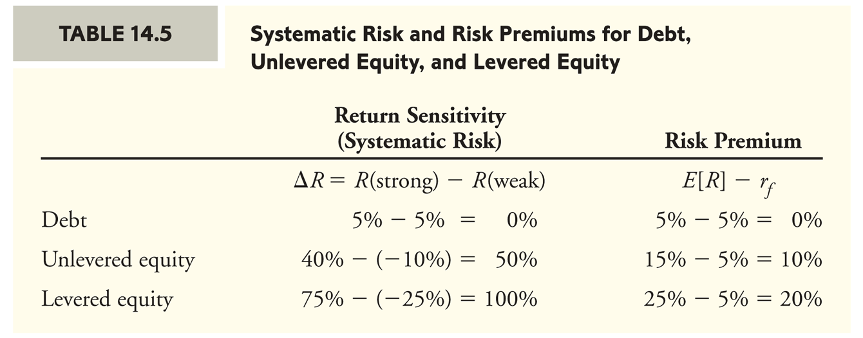
The Effect of Leverage on Risk and Return
The relationship between risk and return can be evaluated more formally by computing the sensitivity of each security’s return to the systematic risk of the economy.

Slide 15
The Effect of Leverage on Risk and Return
In the case of perfect capital markets, if the firm is 100% equity financed, the equity holders will require a 15% expected return.
If the firm is financed 50% with debt and 50% with equity, the debt holders will receive a return of 5%, while the levered equity holders will require an expected return of 25% (because of their increased risk).
Leverage increases the risk of equity even when there is no risk that the firm will default on the debt.
However, note that the average cost of capital (average expected return for investors) with leverage is ½(5%) + ½(25%) = 15%, the same as the unlevered firm.
  If an investor buys all the debt and all the equity that investor owns the entire firm, i.e., owns a portfolio that is equivalent in risk to the unlevered equity.

Slide 16
Modigliani-Miller I
In a perfect capital market, the total value of a firm is equal to the market value of the total cash flows generated by its assets and is not affected by its choice of capital structure.
Assumptions that underlie the theorem:
  Investors and firms can trade the same set of securities at competitive market prices equal to the present value of their future cash flows.
  There are no taxes, transaction costs, or issuance costs associated with security trading.
  A firm’s financing decisions do not change the cash flows generated by its investments, nor do they reveal new information about them.

Slide 17
MM and the Law of One Price
MM established their result with the following argument:
  In the absence of taxes or other transaction costs, the total cash flow paid out to all of a firm’s security holders is equal to the total cash flow generated by the firm’s assets, i.e., the equity and debt securities are pure contingent claims.
    Therefore, by the Law of One Price, the firm’s securities and its assets must have the same total market value (the balance sheet has to balance).

Slide 18
Modigliani-Miller II
Leverage and the Equity Cost of Capital
  MM’s first proposition can be used to derive an explicit relationship between leverage and the equity cost of capital.
  MM Proposition I states that:
    For any capital structure choice, the total market value of the firm’s securities is equal to the market value of unlevered equity or the market value of the firm’s assets.

Slide 19
Modigliani-Miller II
Leverage and the Equity Cost of Capital
  The cash flows from holding unlevered equity can be replicated by holding a portfolio of the firm’s equity and debt.
  Therefore, for any time period the actual return on unlevered equity (R_{U}) is related to the actual returns of levered equity (R_{E}) and debt (R_{D}) by the following formula:

Slide 20
Modigliani-Miller II
Leverage and the Equity Cost of Capital
  Solving this equation for R_{E},the actual return on levered equity:
    The levered equity return equals the unlevered return, plus a premium due to leverage.
      The amount of the premium depends on the amount of leverage, measured by the firm’s market value debt-equity ratio, D/E.

Slide 21
Modigliani-Miller II
Leverage and the Equity Cost of Capital
  MM Proposition II:
    The cost of capital of levered equity is equal to the cost of capital of unlevered equity plus a premium that is proportional to the market value debt-equity ratio.
    Cost of Capital of Levered Equity or equivalently the expected return on levered equity is (because the relations above must hold for all possible actual returns they must hold for expected returns as well):

Slide 22
Modigliani-Miller II: The Example
Leverage and the Equity Cost of Capital
  Recall from above:
    If the firm is all-equity financed, the expected return on unlevered equity is 15%.
    If the firm is financed with $500 of debt, the expected return of the debt is 5%.
    Therefore, according to MM Proposition II, the expected return on equity for the levered firm should be:

Slide 23
Capital Budgeting and the
Weighted Average Cost of Capital
If a firm is unlevered, all of the free cash flows generated by its assets are paid out to its equity holders.
  The market value, risk, and cost of capital for the firm’s assets and its equity coincide and, therefore:

Slide 24
Capital Budgeting and the
Weighted Average Cost of Capital
If a firm is levered, the cost of capital of the assets, r_{A}, is equal to the firm’s weighted average cost of capital.
  Weighted Average Cost of Capital (No Taxes)
  With perfect capital markets, a firm’s WACC is independent of its capital structure and equals its unlevered equity cost of capital, which matches the cost of capital of its assets.
  The balance sheet must balance in value and risk.

Slide 25
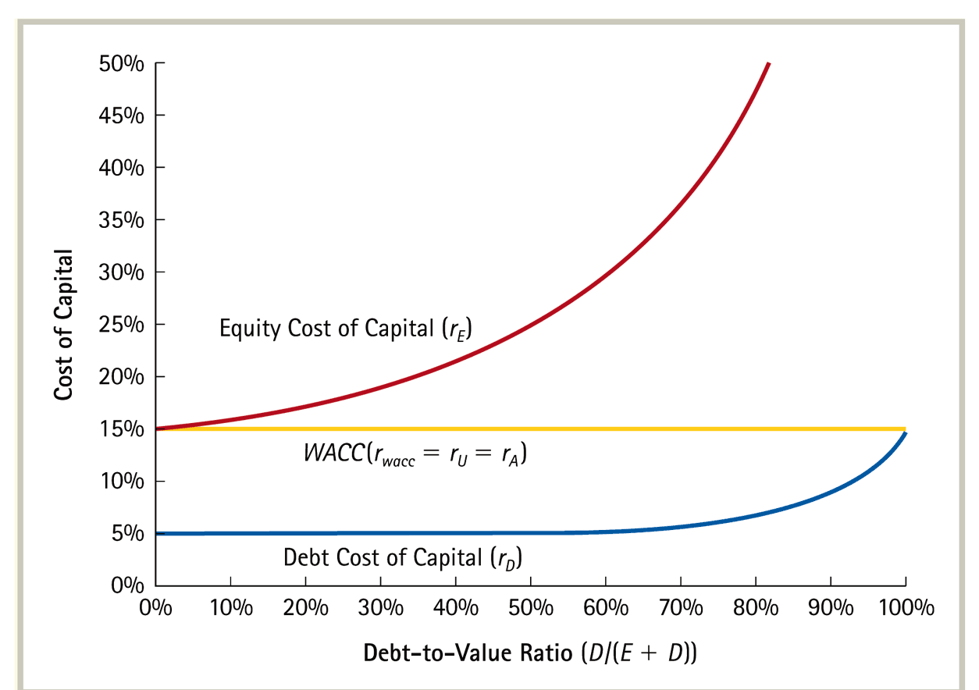
WACC and Leverage with Perfect Capital Markets

Slide 26
Example
  Honeywell International Inc. (HON) has a market debt-equity ratio of 0.5.
  Assume its current debt cost of capital is 6.5%, and its equity cost of capital is 14%.
  If HON issues equity and uses the proceeds to repay its debt and reduce its debt-equity ratio to 0.4, it will lower its debt cost of capital to 5.75%.
  With perfect capital markets, what effect will this transaction have on HON’s equity cost of capital and WACC?
Notes:
26

Slide 27
Example
Solution
  Current WACC
  New Cost of Equity
Notes:
27

Slide 28
Example
Solution (continued)
  New WACC
  The cost of debt capital falls from 6.5% to 5.7% and the cost of equity capital falls from 14% to 13.8% however, the WACC is unchanged. How can that be?
Notes:
28

Slide 29
Levered and Unlevered Betas
The effect of leverage on the risk of a firm’s securities can also be expressed in terms of beta:
  Unlevered beta is a measure of the risk of a firm as if it did not have leverage, which is equivalent to the beta of the firm’s assets.
  If you are trying to estimate the unlevered beta for an investment project, you should base your estimate on the unlevered betas of firms with comparable investments.

Slide 30
Levered and Unlevered Betas
We rearrange this to find:
In the extreme case of risk free debt this simplifies to:
Both equations demonstrate that leverage serves to amplify the market risk of a firm’s assets, β_{U}, raising the market risk of its equity, β_{E}, above β_{U}.
This increase in risk causes the increase in the cost of equity capital that results from increased leverage.

Slide 31
Cash and Net Debt
Holding (excess) cash has the opposite effect of leverage on risk and return and can be viewed as equivalent to negative debt.

Slide 32
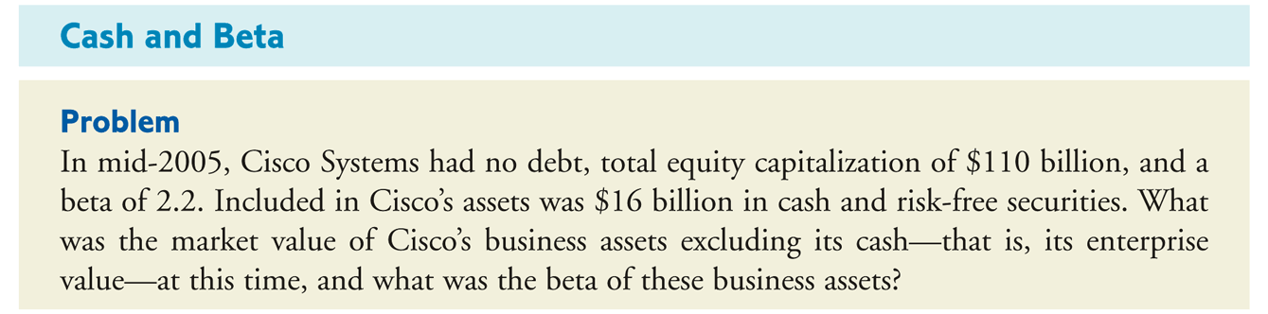
Example

Slide 33
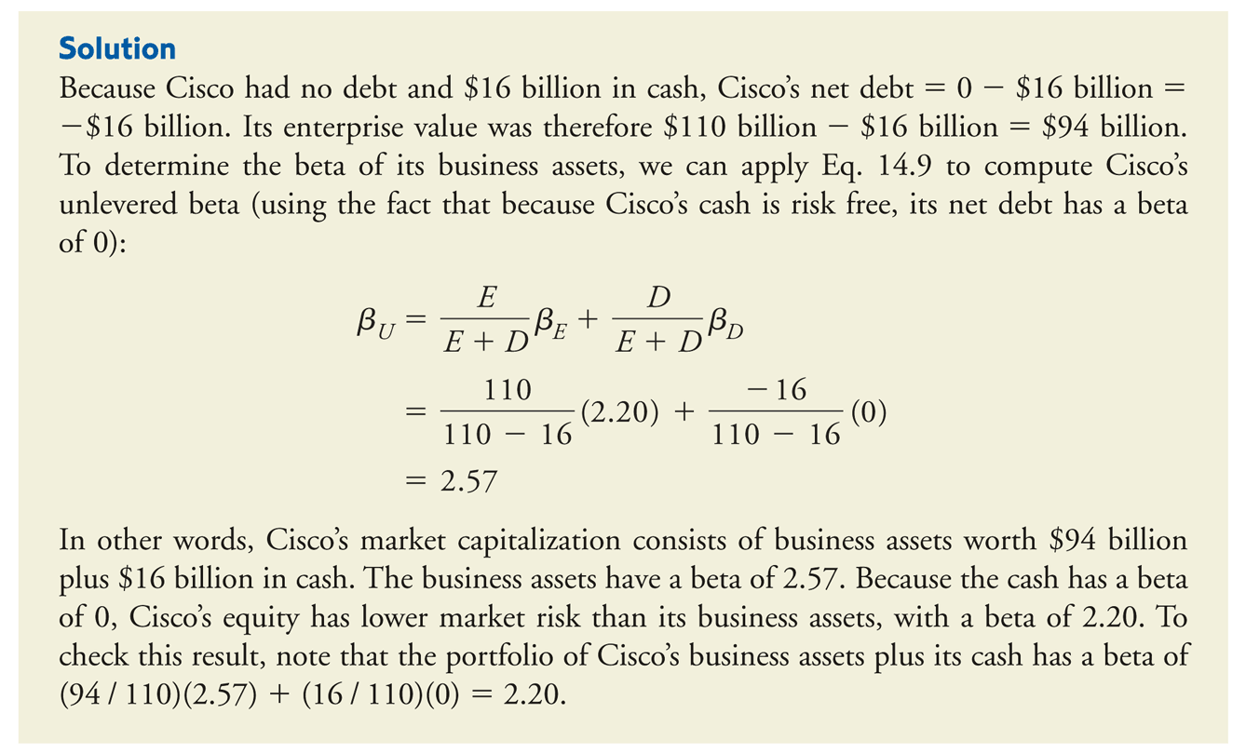
Example

Slide 34
The Interest Tax Shield and Firm Value
MM Proposition I with Taxes
  The total value of the levered firm exceeds the value of the firm without leverage due to the present value of the tax savings from debt.

Slide 35
The Interest Tax Shield with Permanent Debt
Typically, the level of future interest payments is uncertain due to changes in the marginal tax rate, the amount of debt outstanding, the interest rate on that debt, and the risk of the firm.
  For simplicity, we will consider the special case in which the above variables are kept constant.

Slide 36
The Interest Tax Shield with Permanent Debt
Suppose a firm borrows debt D and keeps the debt permanently. If the firm’s marginal tax rate is τ_{c} , and if the debt is riskless with a risk-free interest rate r_{f} , then the interest tax shield each year is τ_{c} × r_{f} × D, and the tax shield can be valued as a perpetuity.
Levered firm value: V^{L} = V^{U} + τ_{c}D

Slide 37
The Weighted Average Cost of Capital with Taxes
With tax-deductible interest, the effective after-tax borrowing rate is r_{D}(1 − τ_{c}) and the weighted average cost of capital becomes

Slide 38
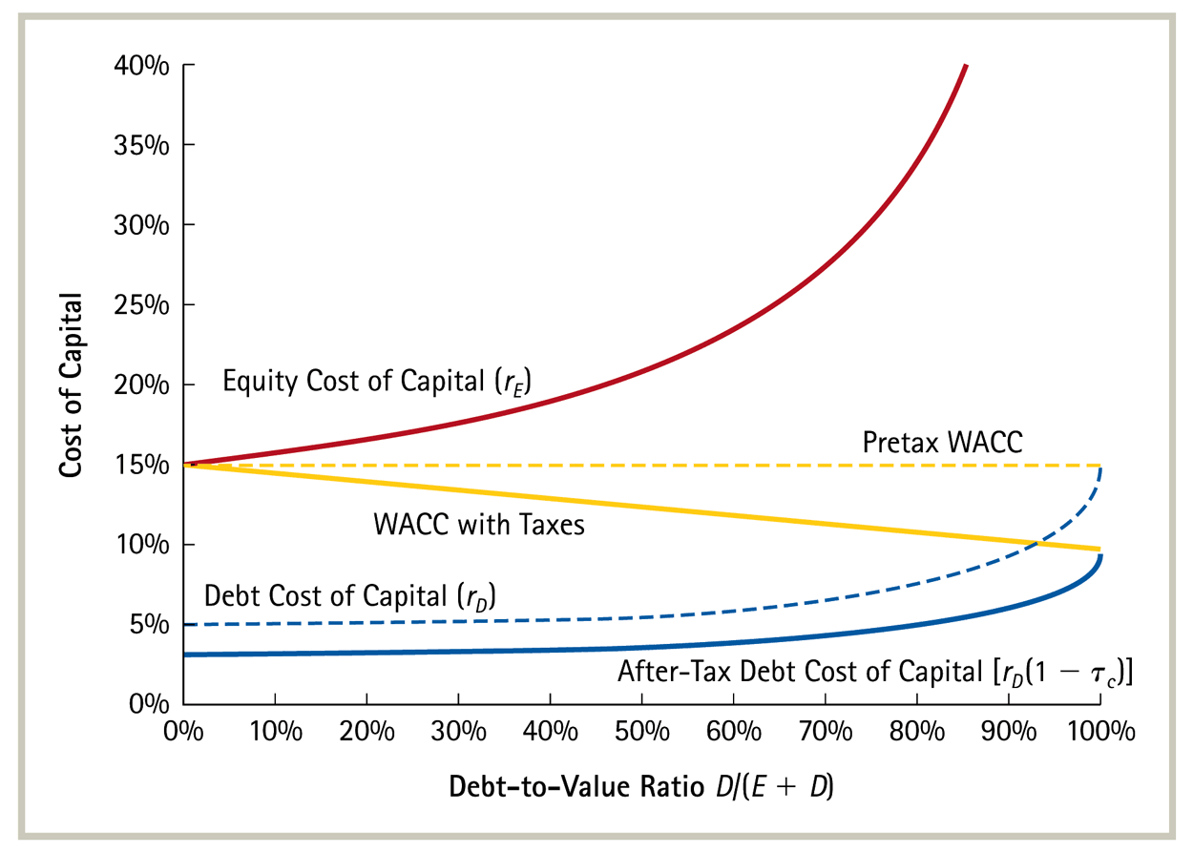
The WACC with and without Corporate Taxes

Slide 39
The Cost of Equity Capital
As the picture indicates the cost of equity capital has the same relationship to the unlevered cost of capital, r_{U}, and the debt to equity ratio.
  In chapter 18 your textbook demonstrates formally that this relation holds as long as the firm acts to maintain a fixed debt to equity ratio.
Clearly:

Slide 40
The Interest Tax Shield with a Target Debt-Equity Ratio
When a firm adjusts its leverage to maintain a target debt-equity ratio, we can compute its value with leverage, V^{L}, by discounting its free cash flow using the weighted average cost of capital.
The value of the interest tax shield can then be found by comparing the value of the levered firm, V^{L}, to the unlevered value, V^{U}, of the free cash flow discounted at the firm’s unlevered cost of capital, the pretax WACC.
V^{L} = V^{U} + PV(Interest Tax Shields), the present value of the interest tax shields is simply more difficult to calculate than it is with permanent debt.

